Slide 1

GEO Blue Planet
Audrey Hasson, PhD
Executive Director EU Coordinator
2026

Slide 2

Bridging the gap between data and societal needs
to deliver actionable information

Slide 3




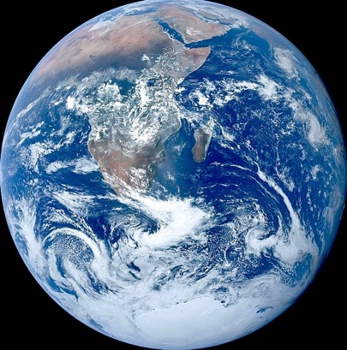






The Ocean Observing Value Chain informs
Decision Making
Data
Observations
Models
Results
Real
Digital
Visualizations
Actions
Knowledge
Decisions
for the Benefit of Society

Slide 4

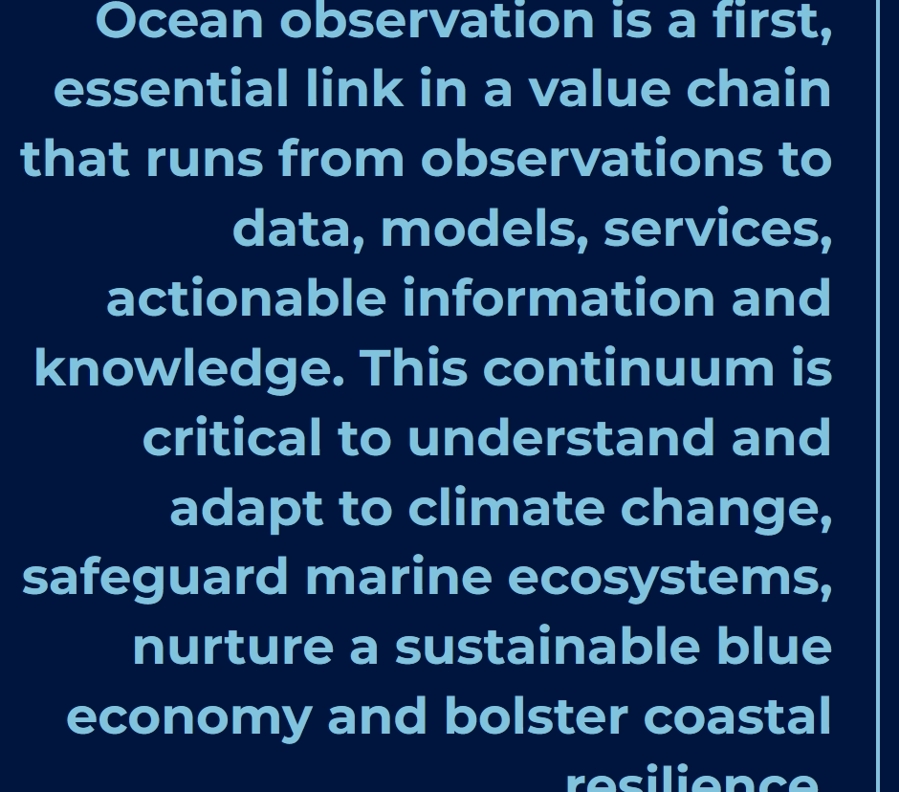
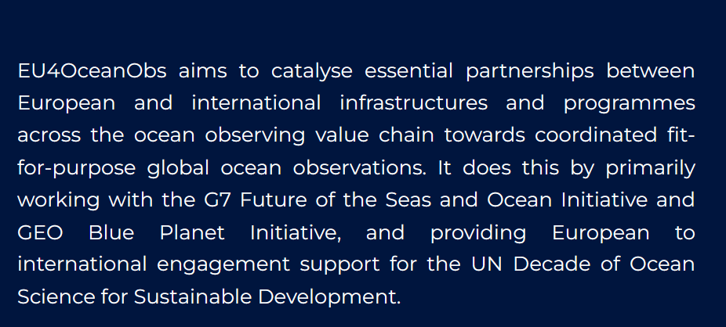


https://www.eu4oceanobs.eu/

Slide 5
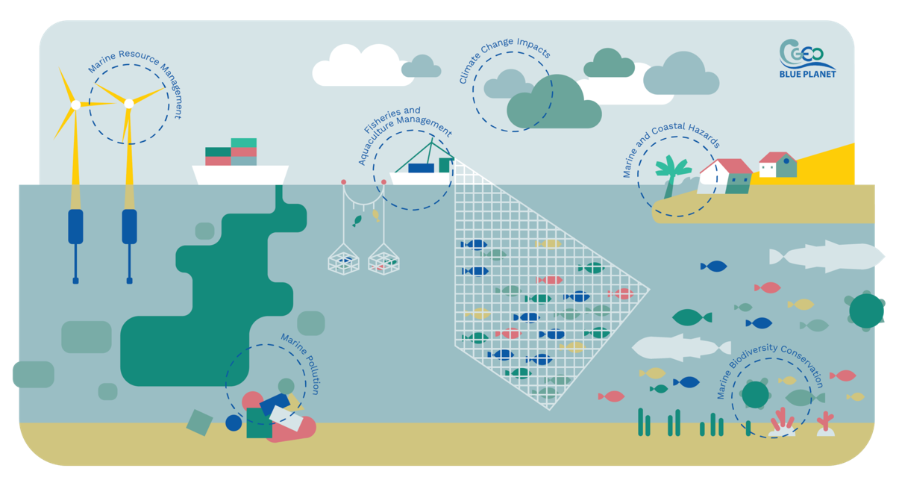

GEO Blue Planet
GEO Blue Planet is an initiative of the Group on Earth Observations (GEO) that focuses on supporting the development and the use of ocean and coastal observations to inform policy and decision-making.
GEO Blue Planet is a network of ocean and coastal experts and representatives from stakeholder groups

Slide 6
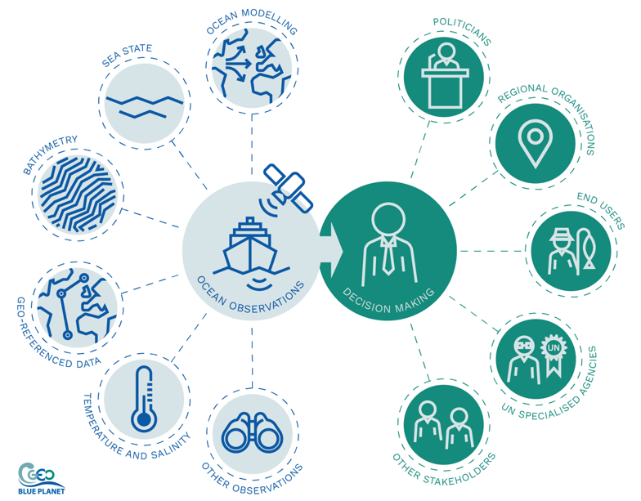

GEO Blue Planet
GEO Blue Planet is an initiative of the Group on Earth Observations (GEO) that focuses on supporting the development and the use of ocean and coastal observations to inform policy and decision-making.
GEO Blue Planet is a network of ocean and coastal experts and representatives from stakeholder groups
  GEO Blue Planet Objectives are to:
    advance and exploit synergies among the many observational programmes devoted to ocean and coastal waters;
    improve engagement with a variety of stakeholders for enhancing the timeliness, quality and range of services delivered; and
    raise awareness of the societal benefits of ocean observations at the public and policy levels.

Slide 7

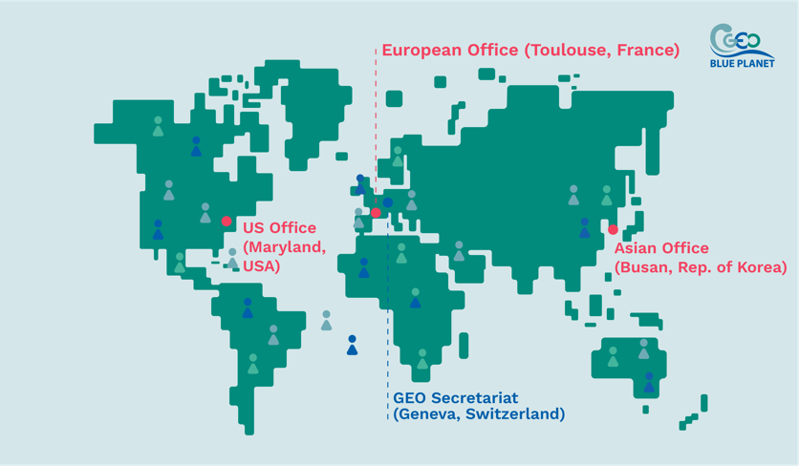





GEO Blue Planet : diverse and inclusive
Steering committee co-chairs from Africa, Central America and Europe, and members from every continent
2015
US Office
​
2020
European Office
​
​2022
Asian Office
​
Strong involvement of early
career ocean professionals

Slide 8
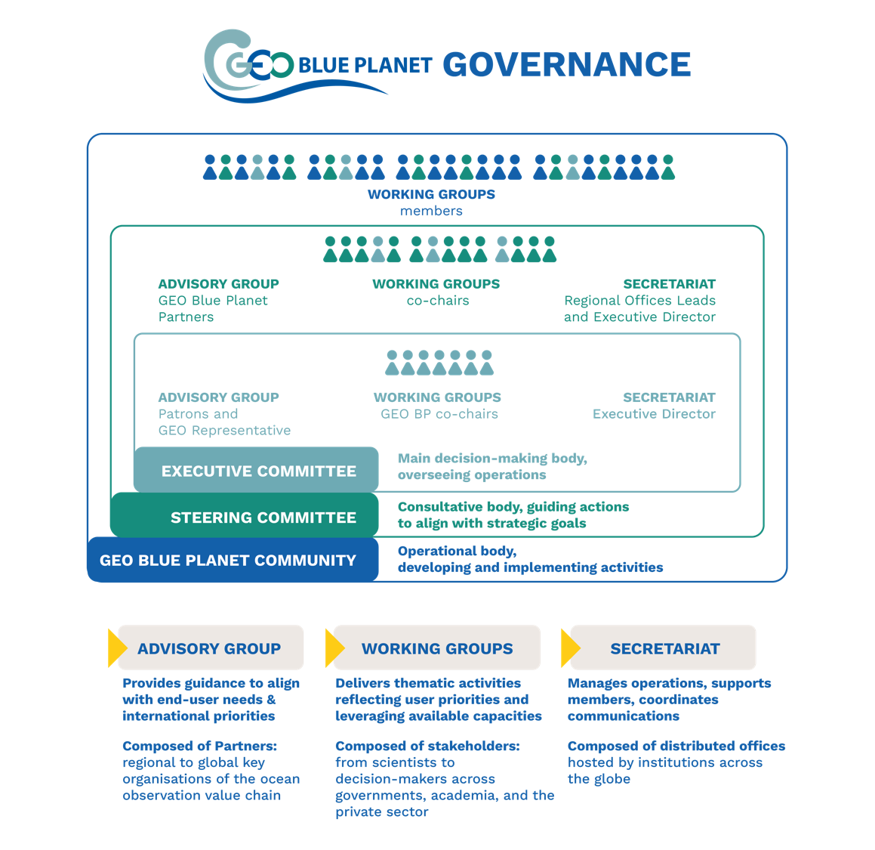
https://geoblueplanet.org/

Slide 9
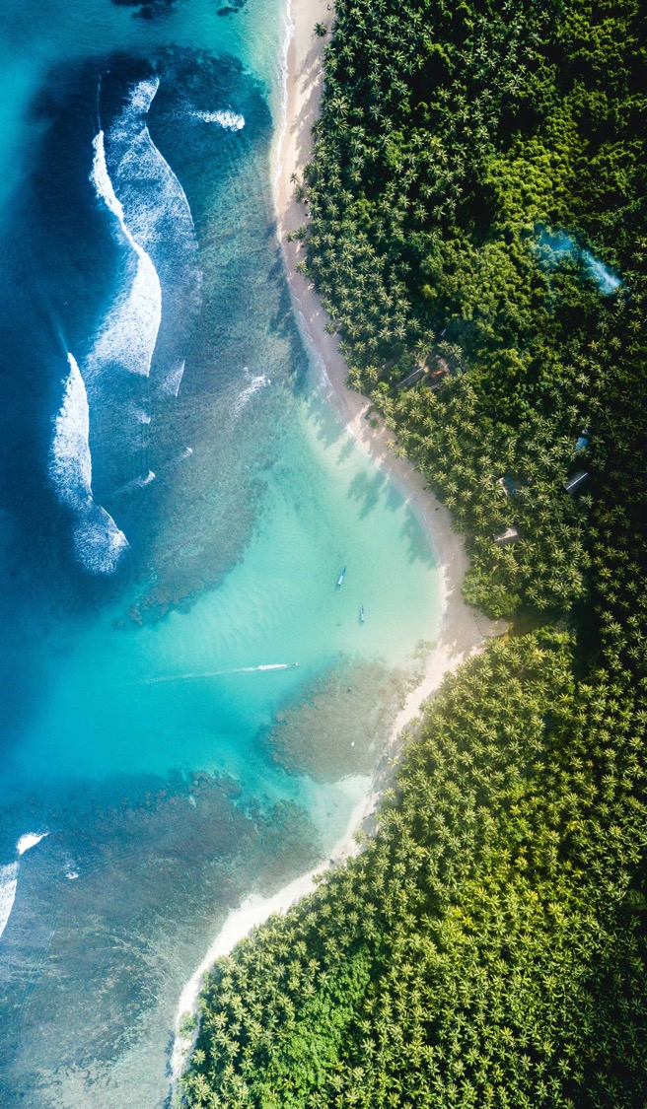


Slide 10

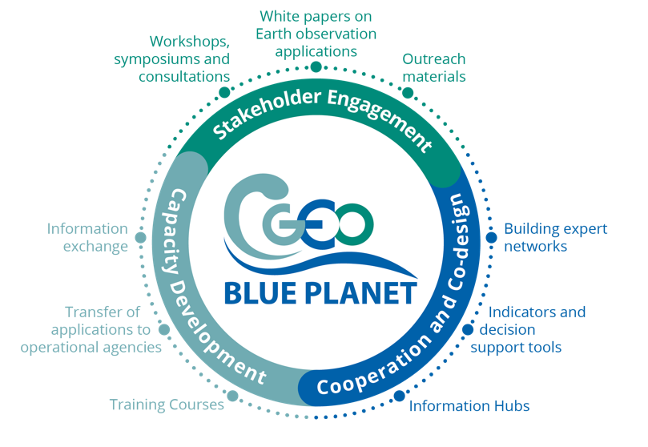








GEO Blue Planet Scope of Action
Activities
Thematic Areas
https://geoblueplanet.org/
Notes:
Increase the project’s visibility amongst key target audiences, highlighting the EU contribution to the G7 FSOI, GEO Blue Planet and relevant UN Ocean Decade programmes, demonstrating outcomes and wider impacts.
Promote Ocean observation-based solutions/applications/services in the European seas and in the Atlantic Ocean, Arctic Ocean. and African coastal waters and on priority activities of WP3/G7 FSOI and WP4/GEO Blue Planet priority topics, which bring value to society while helping to address environmental challenges in line with GEO and Copernicus user-driven actions and relevant Ocean Decade programmes, and adapted (format, style, information) to appeal to the information needs of different stakeholder groups beyond the research marine community (blue economy actors, policy makers, local authorities, industry, entrepreneurs, social scientists)
Showcase the EU as a global and leading actor by promoting the EU contribution to ocean observing value chain. From space and in situ ocean observing (Copernicus, marine ERICs, EOOS, EuroGOOS) to data sharing infrastructures and modelling and forecasting services (EMODnet, Copernicus Marine, WEkEO, EU DTO), to Horizon Europe R&D projects enhancing components of the ocean observing value chain, the work package will work to highlight EU assets.
Demonstrate socio-economic and environmental benefits of the ocean observing value chain (observation, modelling, services) to raise awareness of available Ocean observation-derived services, products and tools, identify blockages along this chain that limit the ability to deliver the necessary applications, increase uptake and use of Ocean data and information products, and increase support for sustained funding. Explain and demonstrate the value of sustained ocean and coastal observations for society.

Slide 11











GEO Blue Planet Thematic Working Groups
Active
Sargassum
Eutrophication
Fisheries
Marine Litter
Climate Adaptation
Dormant
Oil spills
Coastal changes
Coastal flooding
All GEO Blue Planet* activities support and contribute to the UN Decade of Ocean Sciences for Sustainable Development and inclusion and diversity
* In the process of being recognized as an Implementing Partner

Slide 12
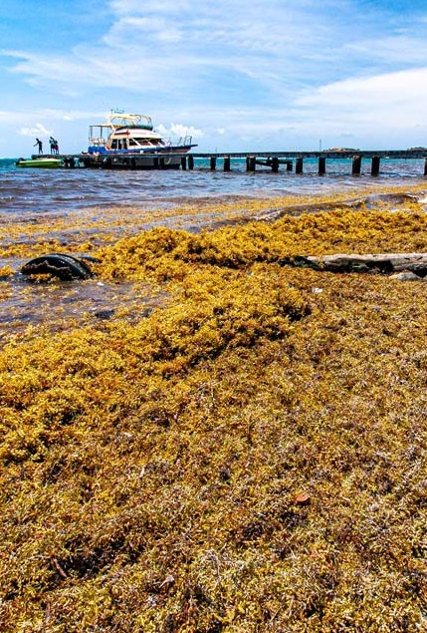






OBJECTIVE
Support operational satellite-based Sargassum monitoring and early warning systems for impacted Tropical Atlantic regions
GOVERNANCE
CO-CHAIRS
Joaquin Trinanes - NOAA CoastWatch/AOML
Edwin Cruz-Rivera - Morgan State University
SECRETARIAT LEAD
Audrey Hasson - Executive Director, GEO Blue Planet
50 MEMBERS from multiple stakeholder groups
ACTIVITY HIGHLIGHTS
Sargassum Challenge at Intergenerational Hackathon, AAORIA Forum, Brazil (April 2026)
Side events at UNOC3 and presence at the One Ocean Science Congress
SargCOOP2 project running until 2027
Sargassum Information Hub updated in collaboration with partners
Sargassum Working Group

Slide 13
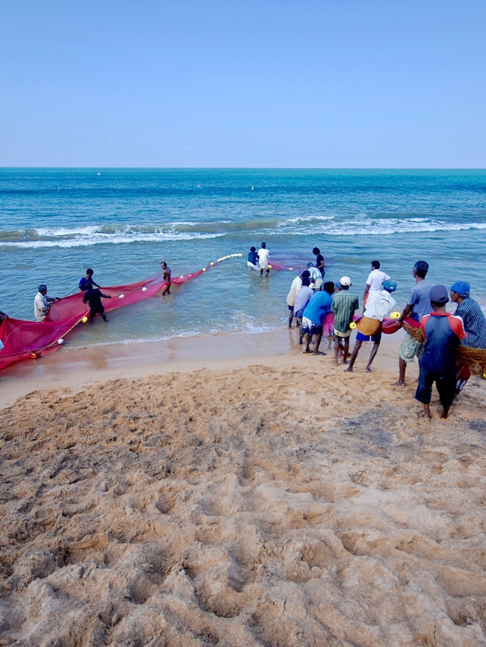
OBJECTIVE
To identify data gaps, support co-designed tools, strengthen best practices, and enable capacity development for living marine resources
GOVERNANCE
CO-CHAIRS: Hassan Moustahfid - NOOA, MBON, Isa Elegbede - Brandenburg University of Technology, MBON, and Pedro Riberio - Indra
SECRETARIAT LEAD: Under recruitment
MEMBERS INCLUDE: Kwame Adu Agyekum - University of Ghana, Bennet Atsu Foli - University of Ghana, Anton Ellenbroek - FAO, Katie Geddes - University of Miami,
Nimit Kumar ICAR-CIFE, Shubha Sathyendranath - Plymouth Marine Laboratory,
Muktha Menon - Indian Council of Agricultural Research
ACTIVITY HIGHLIGHTS
Workshop: Ocean Data to Support Global Sustainable Fisheries Management (April 2026)
  SMS Fisheries Alerts for Bangladesh
  EO and Ocean data to support fisheries and Climate Change modelling
  EO data for onshore and offshore culture fisheries
Fisheries Working Group

Slide 14
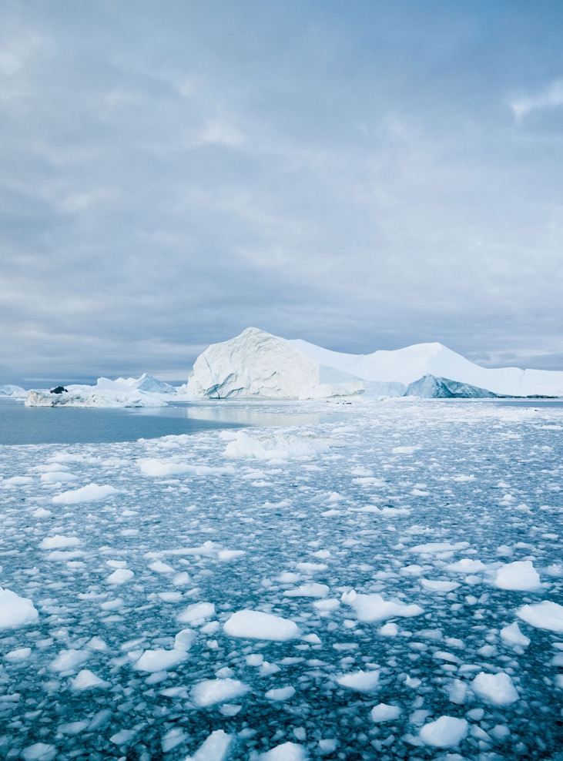


OBJECTIVE
The Climate Adaptation Working Group is a Working Group within GEO Blue Planet that was established to support the integration of Earth Observation intelligence and Climate Services into policy frameworks that improve the capacity of Small Island Developing States (SIDS) and Least Developed Countries (LDCs) to adapt to the coastal and ocean effects of climate change
GOVERNANCE
CO-CHAIRS
Louis Celliers - GERICS/Hereon
Jeremy Gault – University College Cork
SECRETARIAT LEAD
Nikelene Mclean - GEO Blue Planet Programme Officer
Audrey Hasson - Executive Director of GEO Blue Planet
CURRENT MEMBERS INCLUDE: David Cabana - GERICS/Hereon, Jose Moutinho - Kaust National Transformation Institute, Nashwan Matheen - Maldives Space Research Organization,
Lisa-Maria Rebelo - Digital Earth Africa, Rahanna Juman - Institute of Marine Affairs Trinidad and Tobago, Elva Escobar - Universidad Nacional Autonoma de Mexico, Mahesh Pradhan - UNDP, Isabel Garcia Hermosa - Mercator Ocean International, Rui Kotani - GEO Secretariat.
ACTIVITY HIGHLIGHTS
Climate Adaptation Workshop at upcoming GEO Blue Planet Symposium (Barbados, 2027)
ESA/ EC JRC Joint Workshop presentation (June 2026, UK)
COP30 Side-Event “Adaptation across scales and sectors: the case for coastal and ocean adaptation’’ (November 2025, Brazil)
NAP Expo Side-Event Coastal and Ocean Adaptation Workshop (August 2025)
UNFCCC NAP Technical Guidance on Coastal and Ocean Adaptation (August 2025)
EU4OceanObs Value Chain Case Study (2024)
Climate Adaptation Working Group

Slide 15
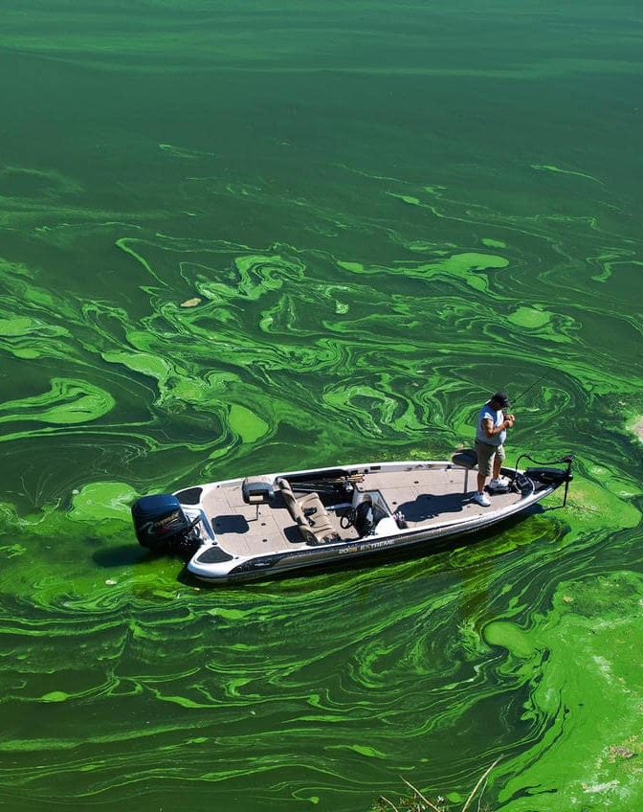
OBJECTIVE
To engage stakeholders, strengthen capacity, and coordinate co-designed marine Earth observation approaches for nutrient tracking and SDG reporting
GOVERNANCE
CO-CHAIRS
Dr. Joan Albert Sánchez - Cabeza
Dany Ghafari - UNEP
SECRETARIAT LEAD
Merrie Beth Neely - GEO BluePlanet
MEMBERS INCLUDE
Ekaterina Poleshchuk - UN Environment, Keith VanGraafeiland - Esri,
Veronica Lance - NOAA, Sathyadev Ramachandran - NOAA, Blake Schaeffer - EPA, Karina Von Shuckmann - Mercator Ocean International, Thomas Jackson - Plymouth Marine Laboratory
ACTIVITY HIGHLIGHTS
Nutrient Monitoring Task Team with UNEP
Data Service Provider Panel at Ocean Colour Science Meeting (December 2025)
Workshop Nutrient Monitoring across the GEO Work Programme (January 2025)
Eutrophication Working Group

Slide 16
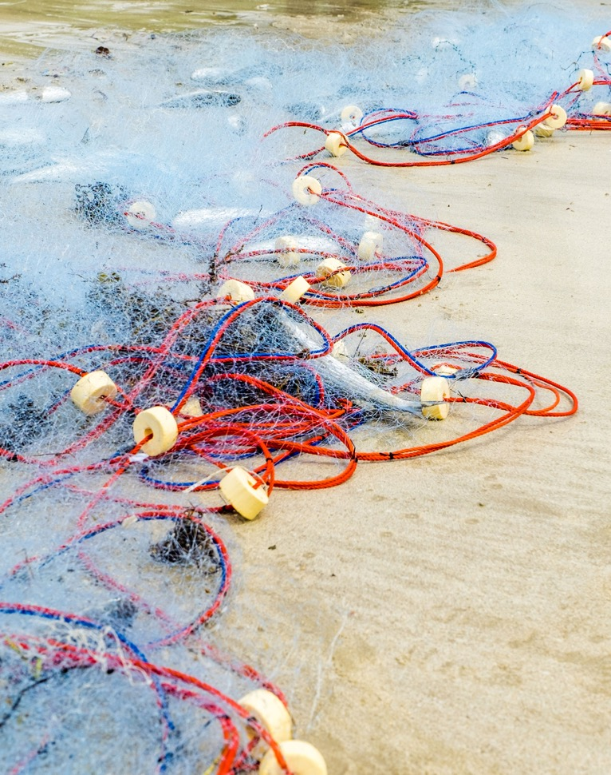

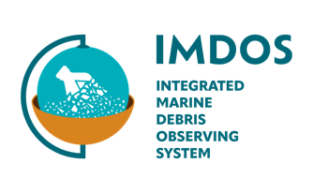
OBJECTIVE
IMDOS will coordinate activities to gradually increase the readiness level of the observing system and data management, aiming for operational capacity by 2030.
GOVERNANCE
11 task teams. GEO Blue Planet supports 3 stakeholder engagement task teams
CO-CHAIRS: Dr. Amy Lusher and Prof. Alexander Turra
SECRETARIAT LEAD: under recruitment
35 MEMBERS
ACTIVITY HIGHLIGHTS
2nd Steering Committee meeting (March 2026, Sopot, Poland)
Signature of IMDOS Declaration of Common Purpose (UNOC3 June 2025, Nice, France)
Official UNOC3 Side-Event « Driving Change with Data : The Integrated Marine Debris Observing System » (June 12th 2025, Nice, France)
Launch and 1st Steering Committee meeting (January 2025, Paris, France)
GOOS endorsed IMDOS as a project
Marine Litter Working Group

Slide 17
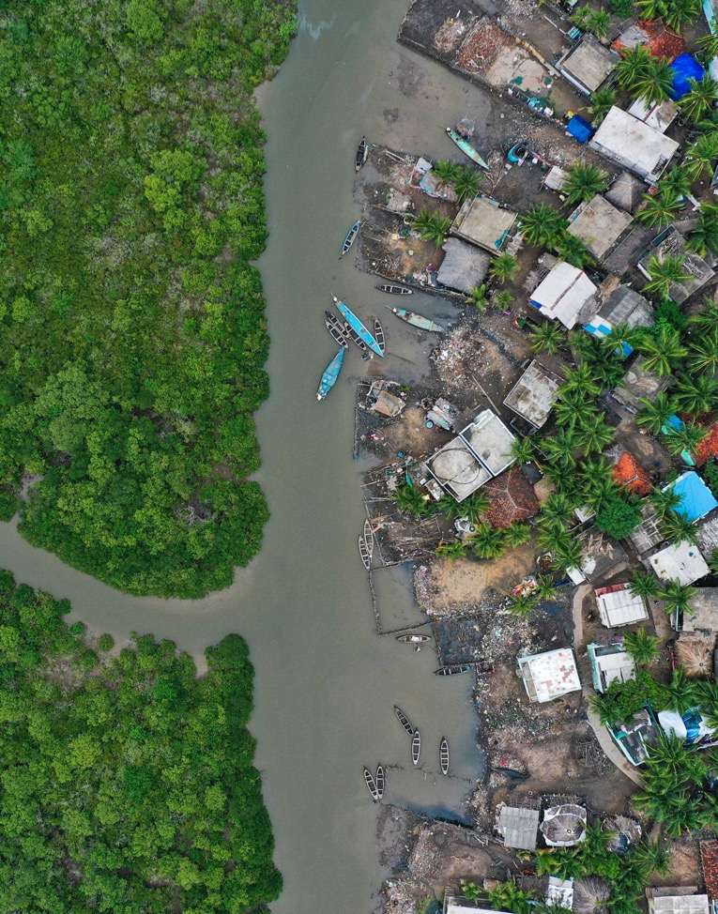
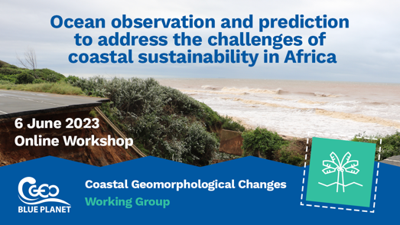
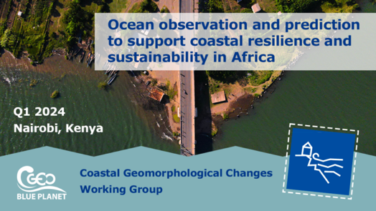

Created in 2022, but no Action Plan and thus inactive.
Outcomes from the workshop entitled “Ocean Observation and Prediction for Coastal Sustainability in Africa” held in Nairobi in March 2024 should feed this WG, although focused on the African continent.
This group could be re-installed in 2026 if stakeholder needs + active members are identified
OPERA (EC DG INTPA) project (2025-2027) included some outcomes of the workshop, and this group could work with them with a wider scope (INTPA is focused on Africa solely)
Coastal Resilience Working Group

Slide 18
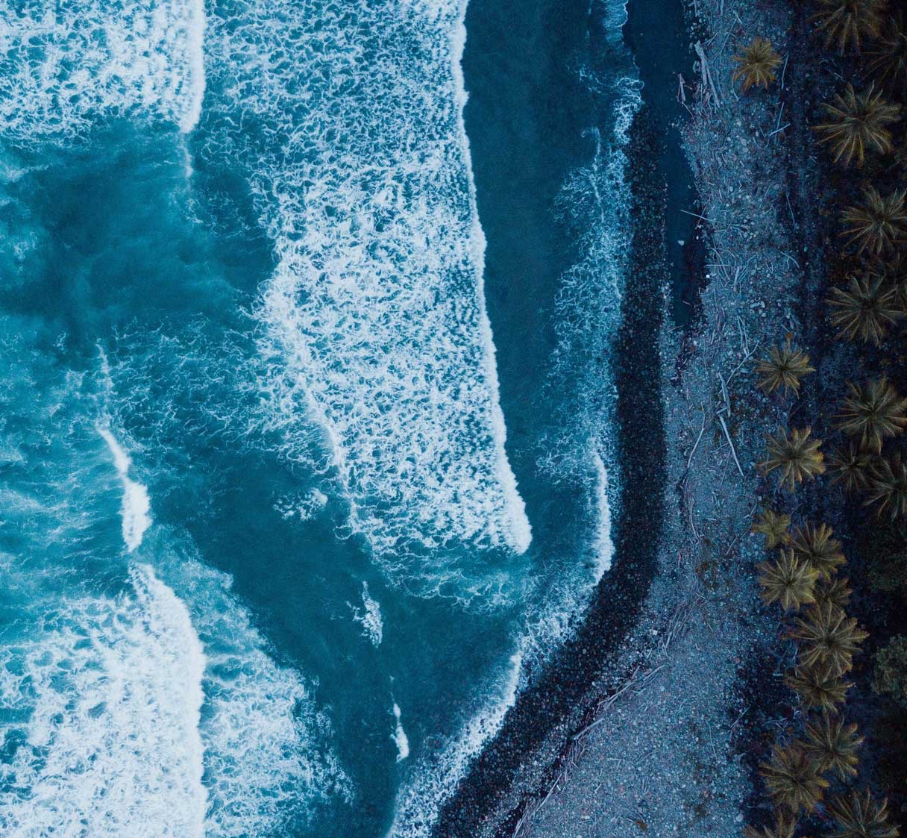
Other Activities

Slide 19





Marine & Coastal Action Group
The EuroGEO Marine and Coastal Action Group drives coordinated, user-focused Earth Observation (EO) solutions to support sustainable development and resilience in Europe’s marine and coastal areas.
WHAT WE DO
Bring European-funded projects together and increase the possibility for synergies, for sharing capabilities and methodologies, and to foster the co-design / co-production of services across different thematics and the EU Member States.
Guide and support the different EU ocean observing projects in order to better align their priorities to the global GEO strategy.
Help members and initiatives to better streamline actions and outcomes to help respond to EU policy and decision making needs.
Support the development of services and help the evolution into downstream applications.
Secretariat: contact@eurogeosec.eu

Slide 20
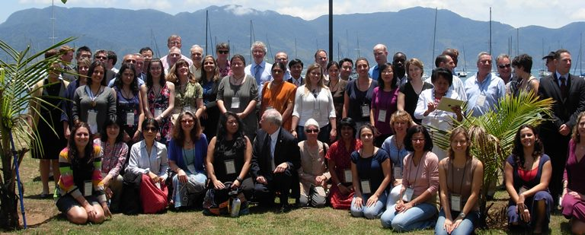

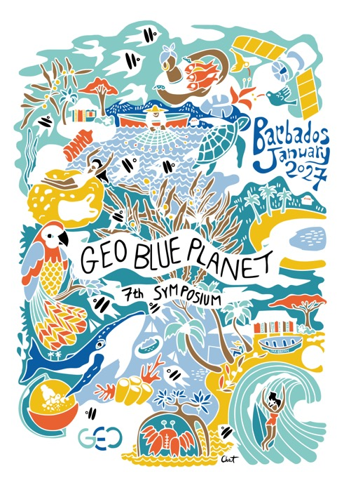





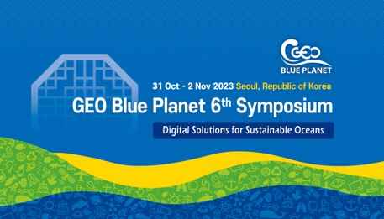
GEO Blue Planet Symposia
The Kick-off symposium was co-sponsored by the Canadian Space Agency (CSA), GEO, INPE and POGO in Brazil, 2012
2027

Slide 21
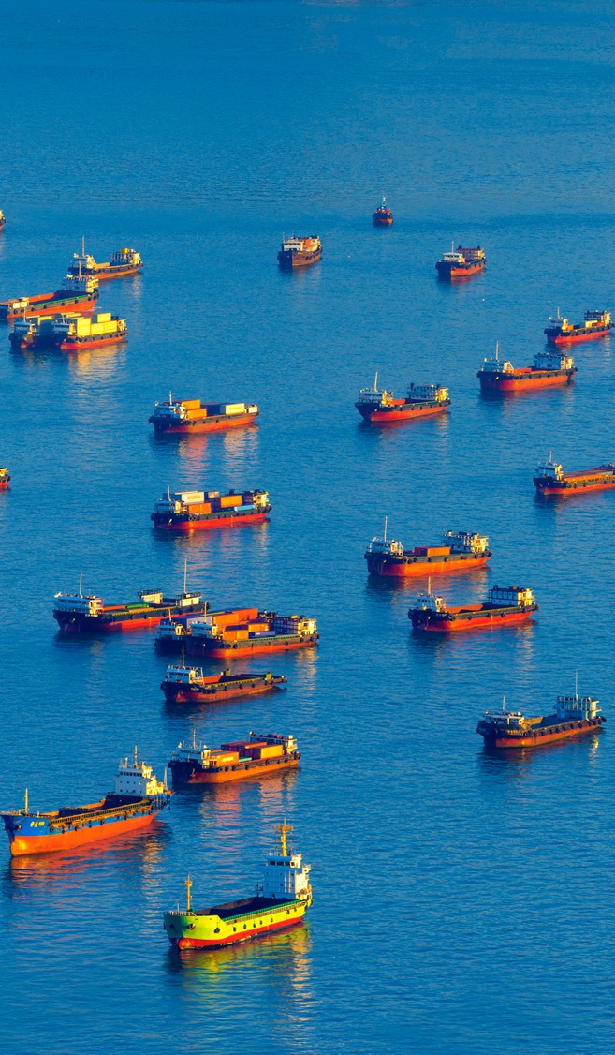


THANK YOU
geoblueplanet.org
sargassumhub.org
imdos.org
geo-blue-planet
info@geoblueplanet.org

