Slide 1
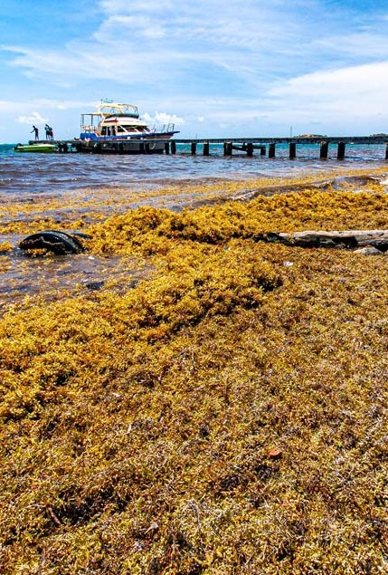







OBJECTIVE
Support operational satellite-based Sargassum monitoring and early warning systems for impacted Tropical Atlantic regions
GOVERNANCE
CO-CHAIRS
Joaquin Trinanes - NOAA CoastWatch/AOML
Edwin Cruz-Rivera - Morgan State University
SECRETARIAT LEAD
Audrey Hasson - Executive Director, GEO Blue Planet
50 MEMBERS from multiple stakeholder groups
ACTIVITY HIGHLIGHTS
Sargassum Challenge at Intergenerational Hackathon, AAORIA Forum, Brazil (April 2026)
Side events at UNOC3 and presence at the One Ocean Science Congress
SargCOOP2 project running until 2027
Sargassum Information Hub updated in collaboration with partners
Sargassum Working Group

