Slide 1
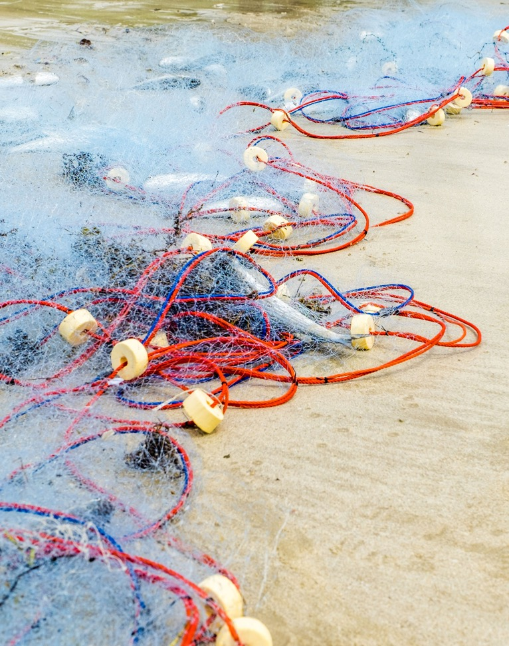





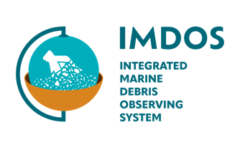


OBJECTIVE
IMDOS will coordinate activities to gradually increase the readiness level of the observing system and data management, aiming for operational capacity by 2030.
GOVERNANCE
11 task teams. GEO Blue Planet supports 3 stakeholder engagement task teams
CO-CHAIRS: Dr. Amy Lusher and Prof. Alexander Turra
SECRETARIAT LEAD: under recruitment
35 MEMBERS
ACTIVITY HIGHLIGHTS
2nd Steering Committee meeting (March 2026, Sopot, Poland)
Signature of IMDOS Declaration of Common Purpose (UNOC3 June 2025, Nice, France)
Official UNOC3 Side-Event « Driving Change with Data : The Integrated Marine Debris Observing System » (June 12th 2025, Nice, France)
Launch and 1st Steering Committee meeting (January 2025, Paris, France)
GOOS endorsed IMDOS as a project
Marine Litter Working Group

