Slide 1
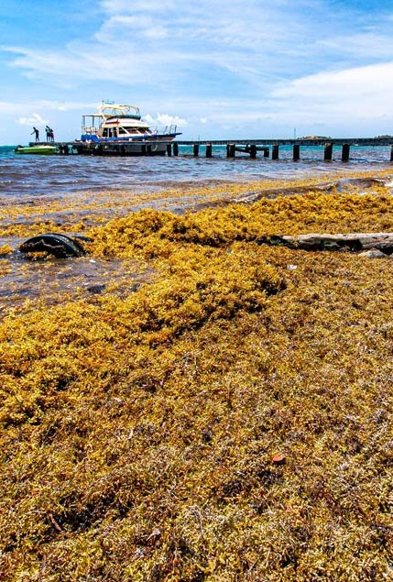
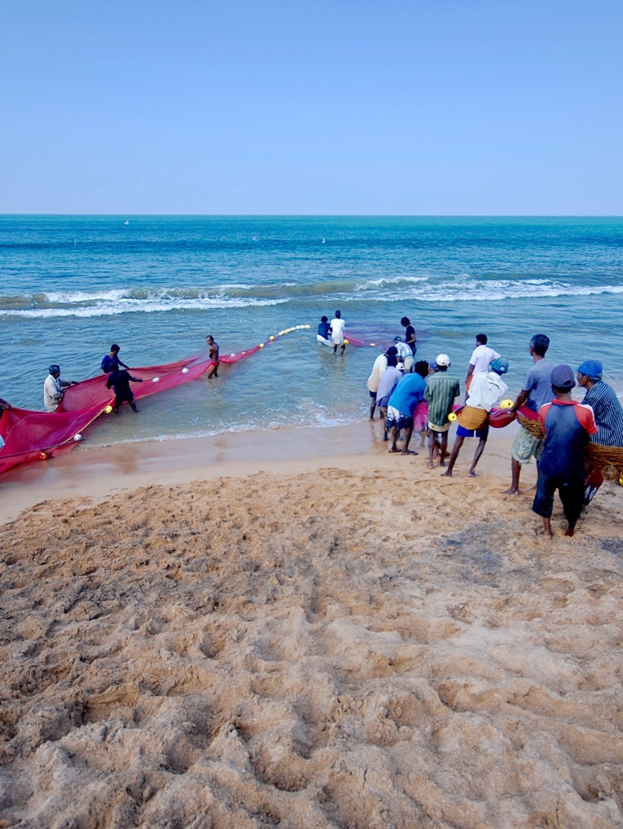







OBJECTIVE
To identify data gaps, support co-designed tools, strengthen best practices, and enable capacity development for living marine resources
GOVERNANCE
CO-CHAIRS: Hassan Moustahfid - NOOA, MBON, Isa Elegbede - Brandenburg University of Technology, MBON, and Pedro Riberio - Indra
SECRETARIAT LEAD: Under recruitment
MEMBERS INCLUDE: Kwame Adu Agyekum - University of Ghana, Bennet Atsu Foli - University of Ghana, Anton Ellenbroek - FAO, Katie Geddes - University of Miami,
Nimit Kumar ICAR-CIFE, Shubha Sathyendranath - Plymouth Marine Laboratory,
Muktha Menon - Indian Council of Agricultural Research
ACTIVITY HIGHLIGHTS
Workshop: Ocean Data to Support Global Sustainable Fisheries Management (April 2026)
  SMS Fisheries Alerts for Bangladesh
  EO and Ocean data to support fisheries and Climate Change modelling
  EO data for onshore and offshore culture fisheries
Fisheries Working Group

