Slide 1
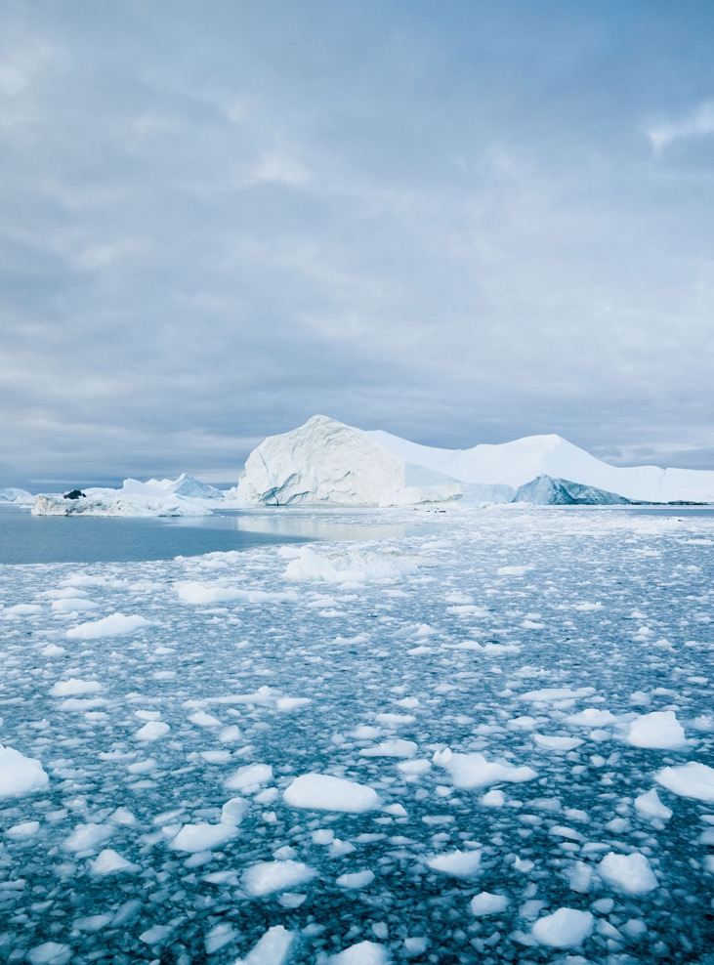







OBJECTIVE
The Climate Adaptation Working Group is a Working Group within GEO Blue Planet that was established to support the integration of Earth Observation intelligence and Climate Services into policy frameworks that improve the capacity of Small Island Developing States (SIDS) and Least Developed Countries (LDCs) to adapt to the coastal and ocean effects of climate change
GOVERNANCE
CO-CHAIRS
Louis Celliers - GERICS/Hereon
Jeremy Gault – University College Cork
SECRETARIAT LEAD
Nikelene Mclean - GEO Blue Planet Programme Officer
Audrey Hasson - Executive Director of GEO Blue Planet
CURRENT MEMBERS INCLUDE: David Cabana - GERICS/Hereon, Jose Moutinho - Kaust National Transformation Institute, Nashwan Matheen - Maldives Space Research Organization,
Lisa-Maria Rebelo - Digital Earth Africa, Rahanna Juman - Institute of Marine Affairs Trinidad and Tobago, Elva Escobar - Universidad Nacional Autonoma de Mexico, Mahesh Pradhan - UNDP, Isabel Garcia Hermosa - Mercator Ocean International, Rui Kotani - GEO Secretariat.
ACTIVITY HIGHLIGHTS
Climate Adaptation Workshop at upcoming GEO Blue Planet Symposium (Barbados, 2027)
ESA/ EC JRC Joint Workshop presentation (June 2026, UK)
COP30 Side-Event “Adaptation across scales and sectors: the case for coastal and ocean adaptation’’ (November 2025, Brazil)
NAP Expo Side-Event Coastal and Ocean Adaptation Workshop (August 2025)
UNFCCC NAP Technical Guidance on Coastal and Ocean Adaptation (August 2025)
EU4OceanObs Value Chain Case Study (2024)
Climate Adaptation Working Group

