Slide 1

GEO Blue Planet
Audrey Hasson, PhD
Executive Director EU Coordinator
2025

Slide 2

Bridging the gap between data and societal needs
to deliver actionable information

Slide 3




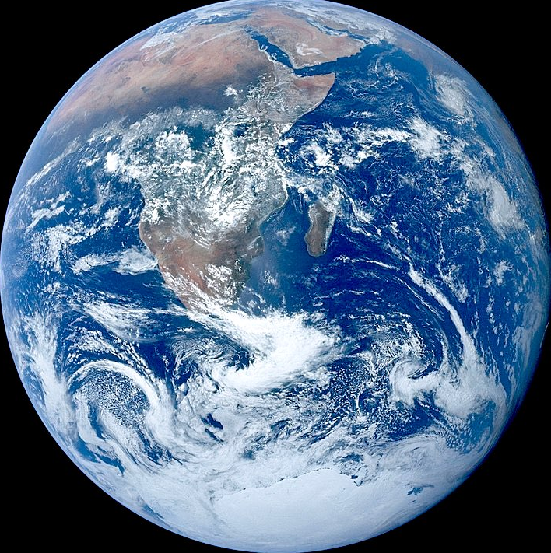
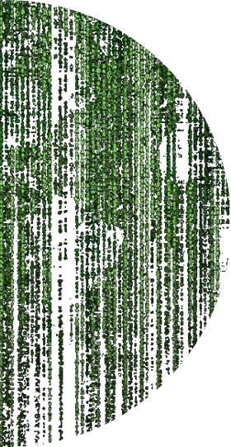





The Ocean Observing Value Chain informs Decision Making
Data
Observations
Models
Results
Real
Digital
Visualizations
Actions
Knowledge
Decisions
for the Benefit of Society

Slide 4

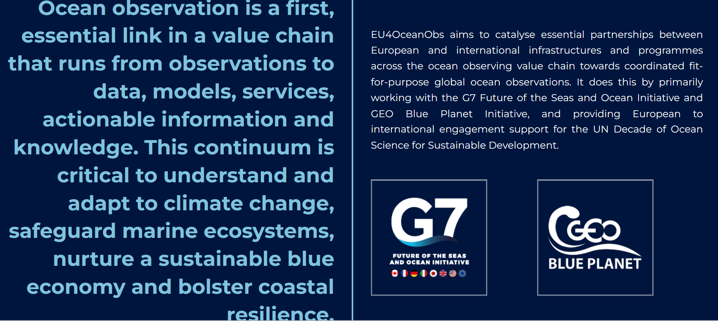

https://www.eu4oceanobs.eu/

Slide 5
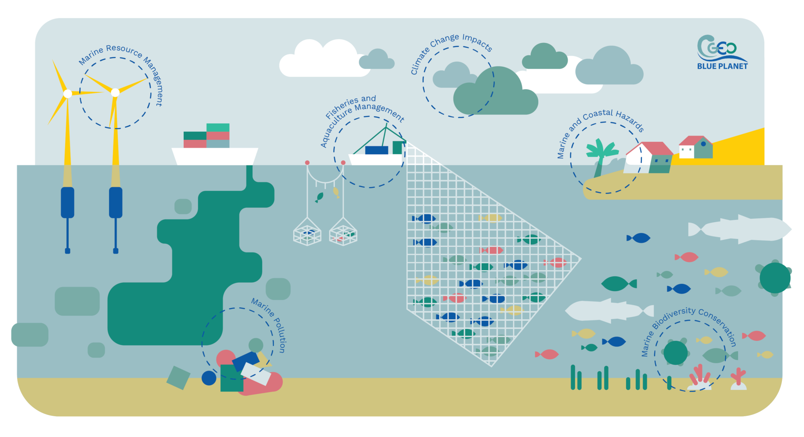

GEO Blue Planet
GEO Blue Planet is an initiative of the Group on Earth Observations (GEO) that focuses on supporting the development and the use of ocean and coastal observations to inform policy and decision-making.
GEO Blue Planet is a network of ocean and coastal experts and representatives from stakeholder groups

Slide 6
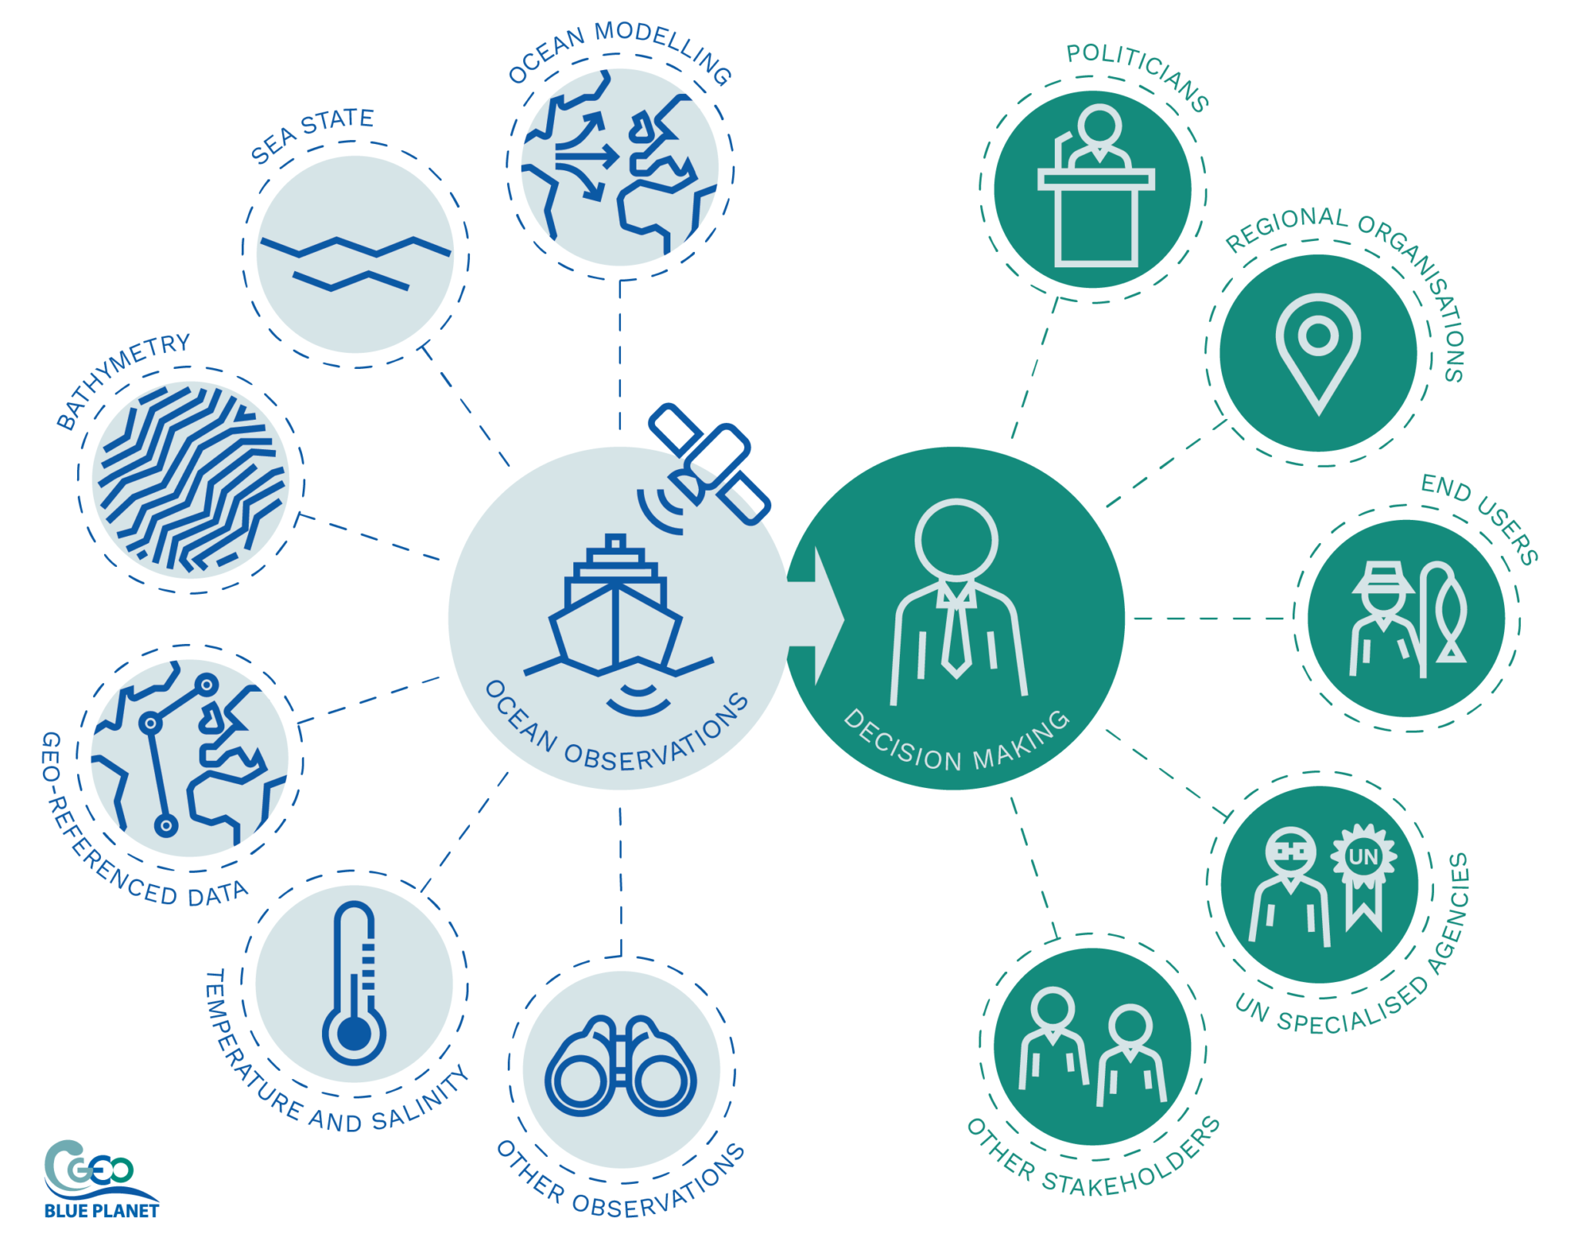

GEO Blue Planet
GEO Blue Planet is an initiative of the Group on Earth Observations (GEO) that focuses on supporting the development and the use of ocean and coastal observations to inform policy and decision-making.
GEO Blue Planet is a network of ocean and coastal experts and representatives from stakeholder groups
GEO Blue Planet Objectives are to:
advance and exploit synergies among the many observational programmes devoted to ocean and coastal waters;
improve engagement with a variety of stakeholders for enhancing the timeliness, quality and range of services delivered; and
raise awareness of the societal benefits of ocean observations at the public and policy levels.
https://geoblueplanet.org/
Notes:
Background information for those who are not familiar with GEO Blue Planet
Bridging the gap between data and decision making
Co-designed and data-based information for decision makers

Slide 7

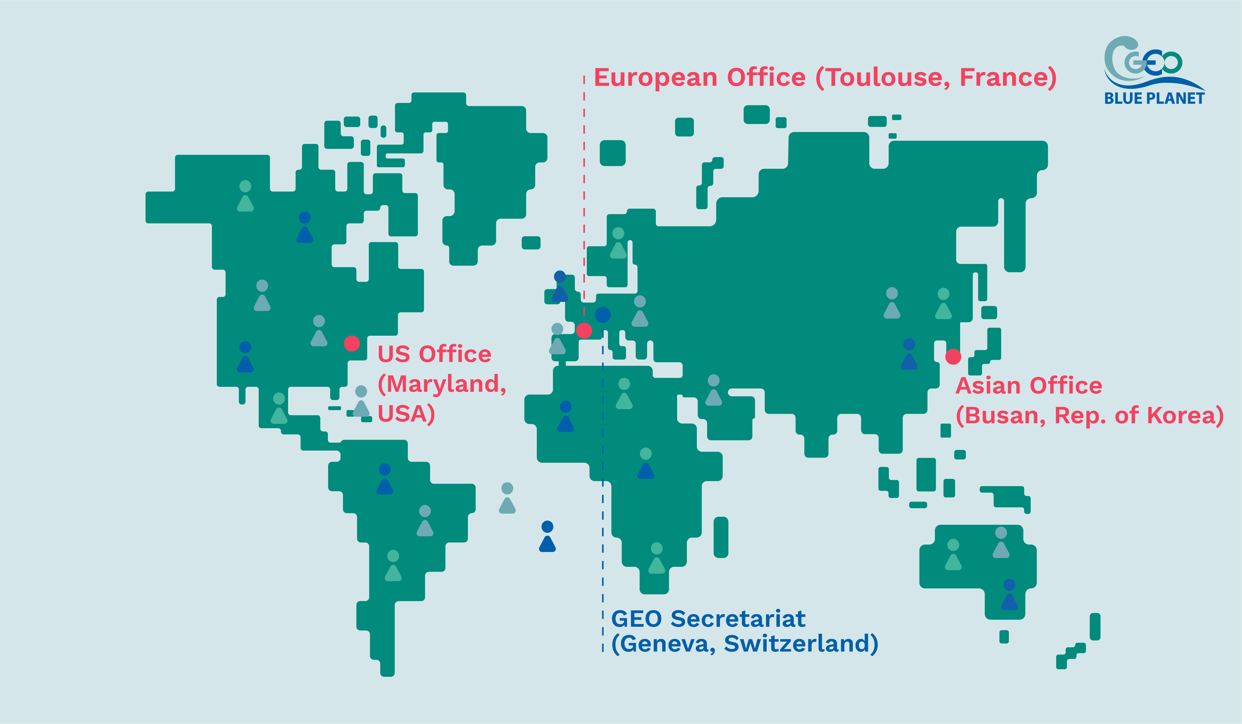





GEO Blue Planet : diverse and inclusive
Steering committee co-chairs from Africa, Central America and Europe, and members from every continent
2015
US Office
​
2020
European Office
​
​2022
Asian Office
​
Strong involvement of early career ocean professionals
https://geoblueplanet.org/

Slide 8
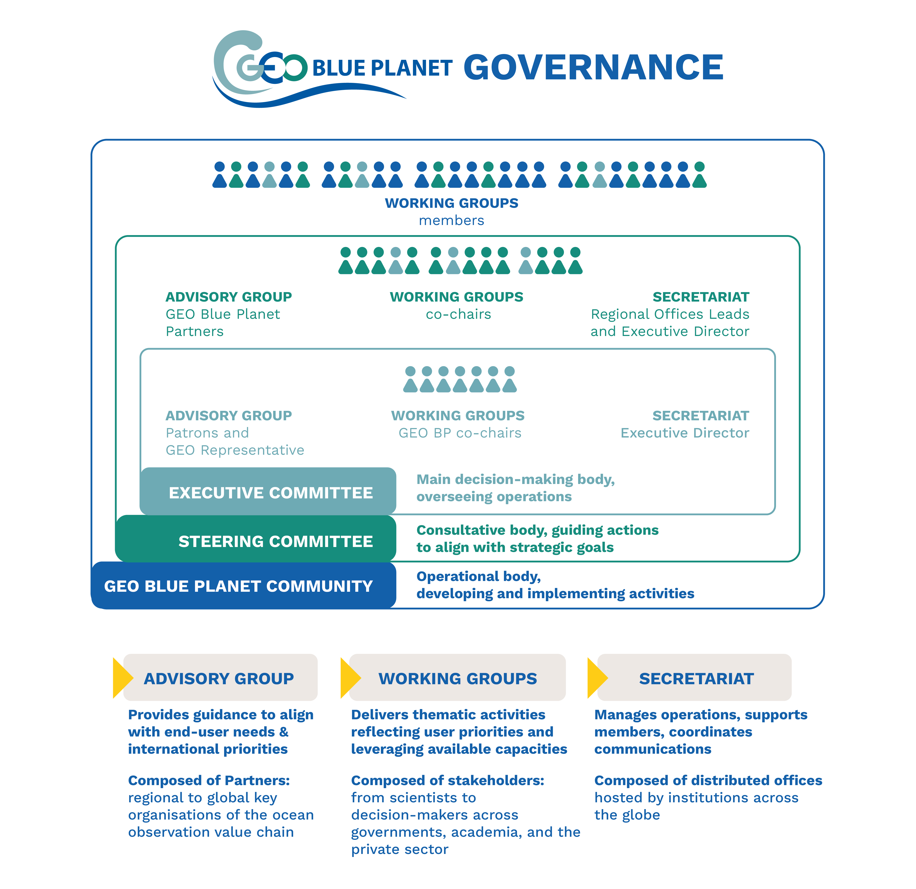
https://geoblueplanet.org/

Slide 9
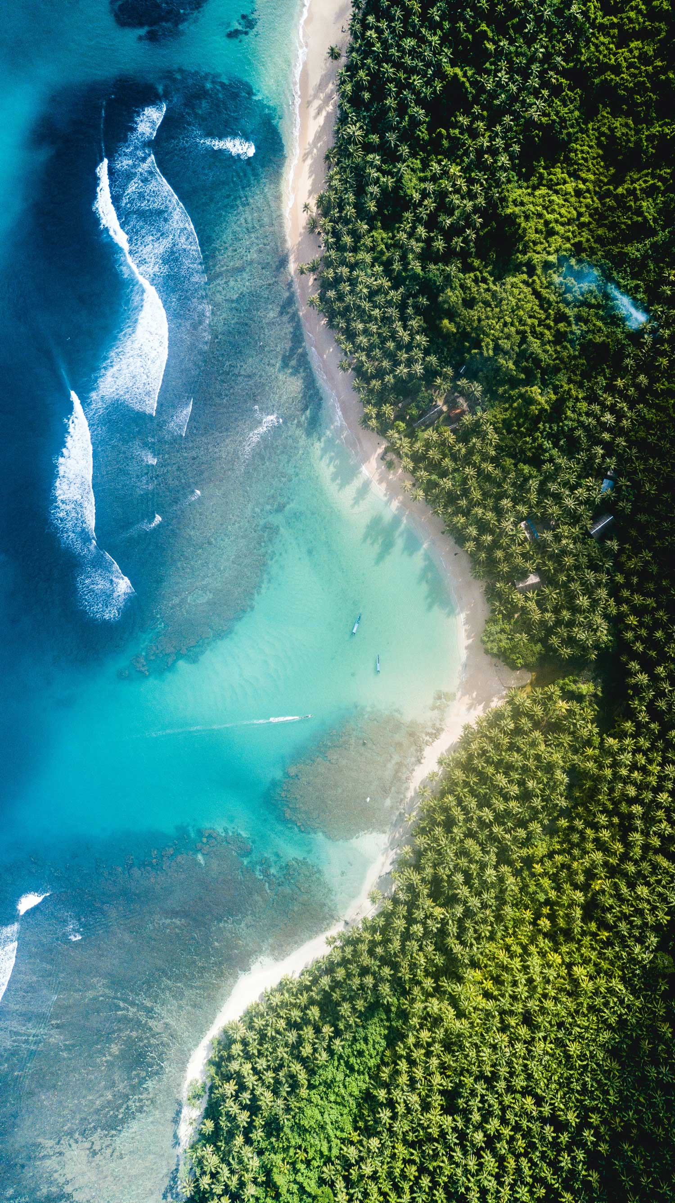
Jose Moutinho
Ana Carolina Ruiz-Fernandez
Kwame Adu Agyekum

Slide 10
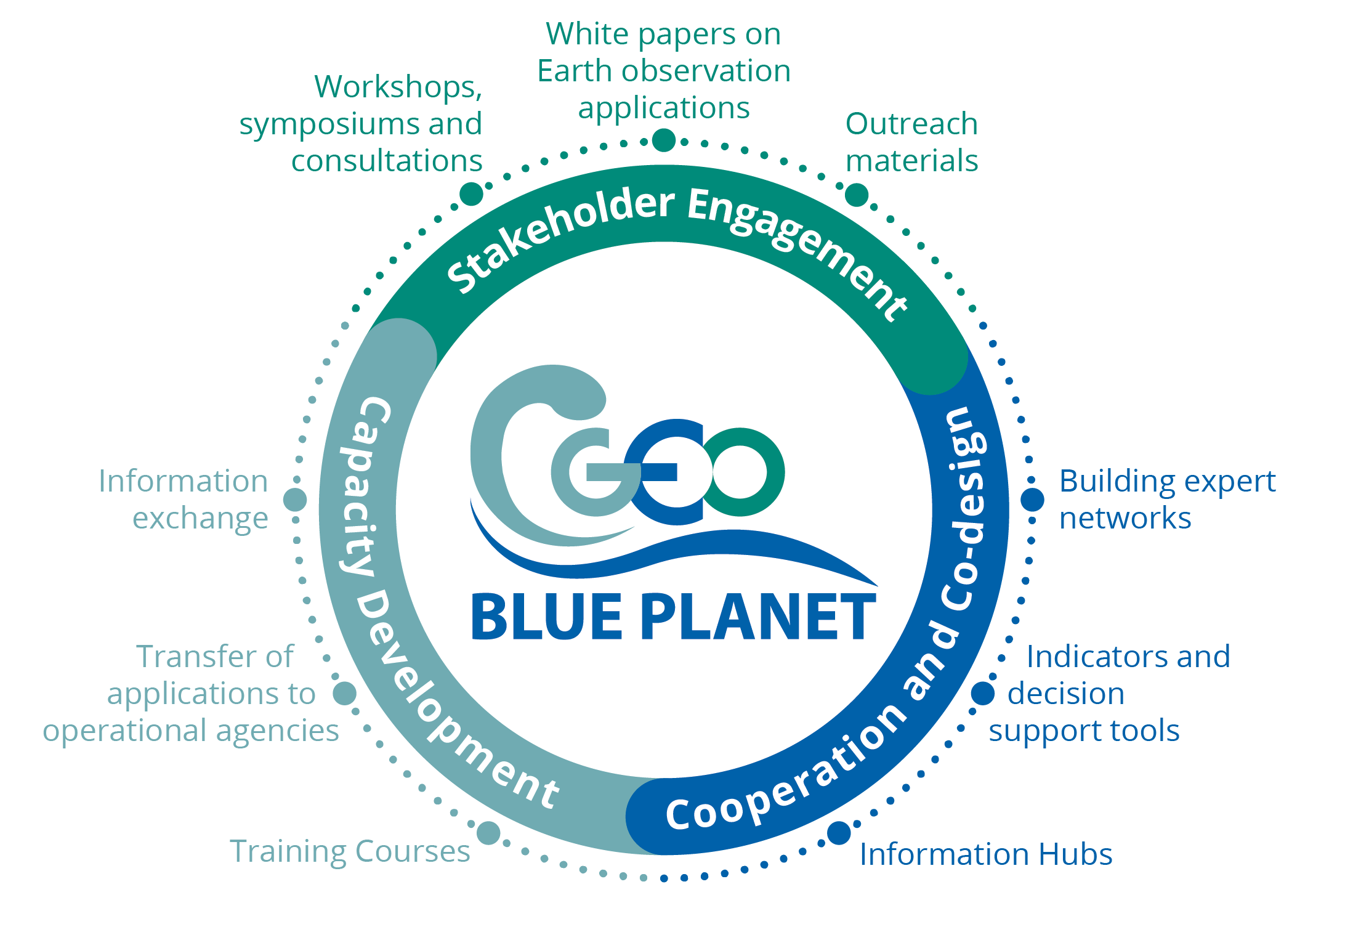








GEO Blue Planet Scope of Action
Activities
Thematic Areas
https://geoblueplanet.org/
Notes:
Increase the project’s visibility amongst key target audiences, highlighting the EU contribution to the G7 FSOI, GEO Blue Planet and relevant UN Ocean Decade programmes, demonstrating outcomes and wider impacts.
Promote Ocean observation-based solutions/applications/services in the European seas and in the Atlantic Ocean, Arctic Ocean. and African coastal waters and on priority activities of WP3/G7 FSOI and WP4/GEO Blue Planet priority topics, which bring value to society while helping to address environmental challenges in line with GEO and Copernicus user-driven actions and relevant Ocean Decade programmes, and adapted (format, style, information) to appeal to the information needs of different stakeholder groups beyond the research marine community (blue economy actors, policy makers, local authorities, industry, entrepreneurs, social scientists)
Showcase the EU as a global and leading actor by promoting the EU contribution to ocean observing value chain. From space and in situ ocean observing (Copernicus, marine ERICs, EOOS, EuroGOOS) to data sharing infrastructures and modelling and forecasting services (EMODnet, Copernicus Marine, WEkEO, EU DTO), to Horizon Europe R&D projects enhancing components of the ocean observing value chain, the work package will work to highlight EU assets.
Demonstrate socio-economic and environmental benefits of the ocean observing value chain (observation, modelling, services) to raise awareness of available Ocean observation-derived services, products and tools, identify blockages along this chain that limit the ability to deliver the necessary applications, increase uptake and use of Ocean data and information products, and increase support for sustained funding. Explain and demonstrate the value of sustained ocean and coastal observations for society.

Slide 11











GEO Blue Planet Thematic Working Groups
Active
Sargassum
Eutrophication
Fisheries
Marine Litter
Climate Adaptation
Dormant
Oil spills
Coastal changes
Coastal flooding
All GEO Blue Planet* activities support and contribute to the UN Decade of Ocean Sciences for Sustainable Development and inclusion and diversity
* In the process of being recognized as an Implementing Partner

Slide 12
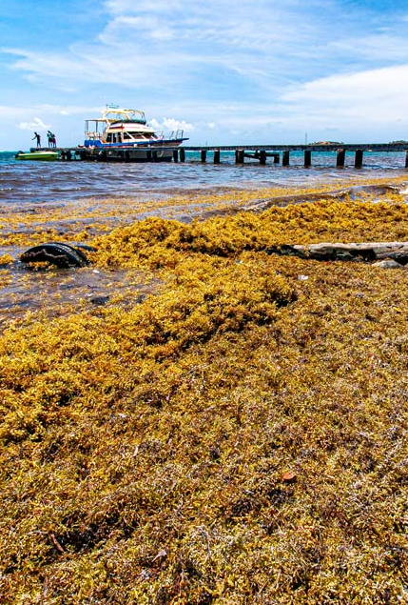
Terms of References and Action Plan are being updated, to reflect the new composition of the WG as well as current actions.
Monthly meetings with 1 to 2 presentations (30’) + general business (30’)
A large group of about 50 members (25+ active), from all stakeholder groups
6 task teams (3 identified as priorities)
Actions are being funded by different sources - The WG acts as focal point for funders and fund seekers
WG is identified by main actors (IOCARIBE, UNEP Cartagena conv., World Bank, EC …)
Impact story video in progress, will be launched at GEO Global Forum in May
Sargassum Information Hub is being updated (supported by EU Office), scope is being widened in collaboration with partners
SargCOOP2 project will fund some actions, launch end of March.
WG will most likely host side events (blue and green) at UNOC, + poster at OOSC + presentation at the Digital Ocean Pavillion
GEO Global Forum : Sargassum community event proposed
Sargassum Working Group

Slide 13
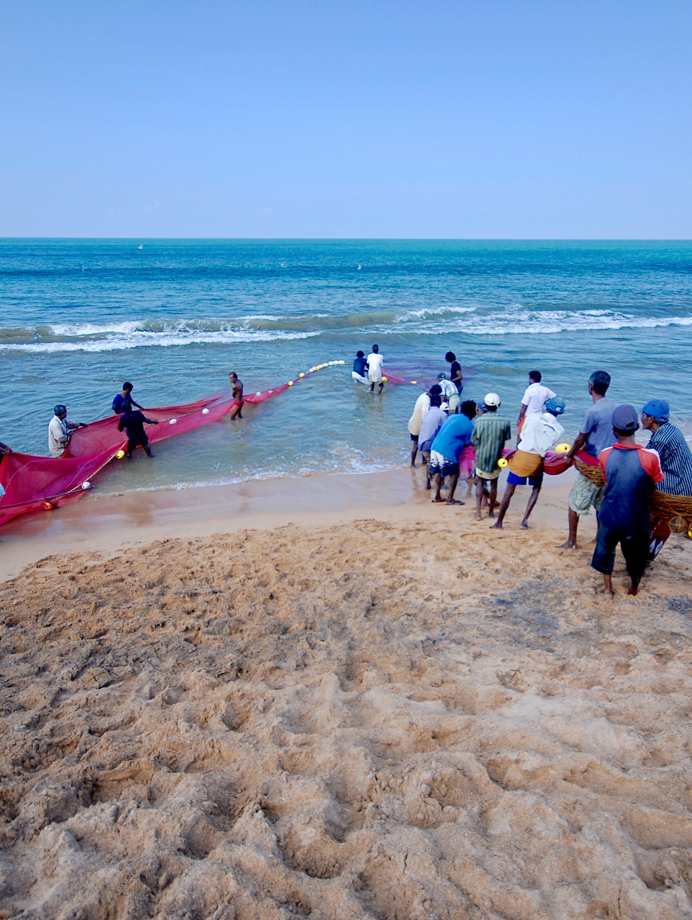
A call for new members has been open, to ensure better drive and representation of stakeholders
Monthly meetings with 1 presentation and general business
Sec duties being transferred to Daphne Lecellier (EU Office)
6 Task teams, 3 active but lacking momentum
New co-chairs will be elected from/by members in the coming weeks
New members will be on-boarded to reach about 20 members (rule of thumb 50% will remain active long-term) : including representation from stakeholders (RMFOs, ICES, National Fisheries dpt…)
Still in the process of organising a first workshop with the RSN -> now planned for the fall
WG activities will be presented at OOSC, and UNOC (Digital Ocean Pavillion)
Fisheries Working Group

Slide 14
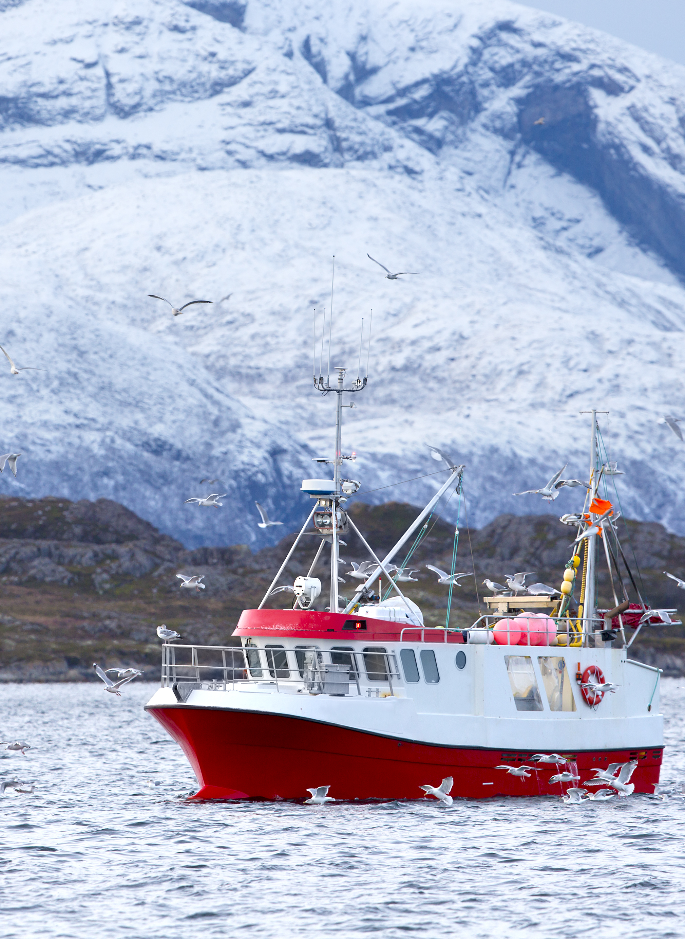

Supplementary Material to the UNFCCC National Adaptation Plans “inclusion of coastal and ocean adaptation requirements in the development of National Adaptation Plans”
This WG has no terms of reference (thus no member list)
Sole action is a study (12 co-authors), lead by Louis Celliers (Hereon) to be declined in
Supplementary material to the UNFCCC NAPs
Technical report
The EU office has contracted a scientific communication team to support / adapt the writing + design to UNFCCC standards
Launch at NAPexpo in Zambia (April 2025)
Nikelene Mclean has proposed to start up this WG, but funding would be appropriate for the amount of work needed
Side event to be proposed to UNOC (onboard German Ship)
Climate Adaptation Working Group

Slide 15
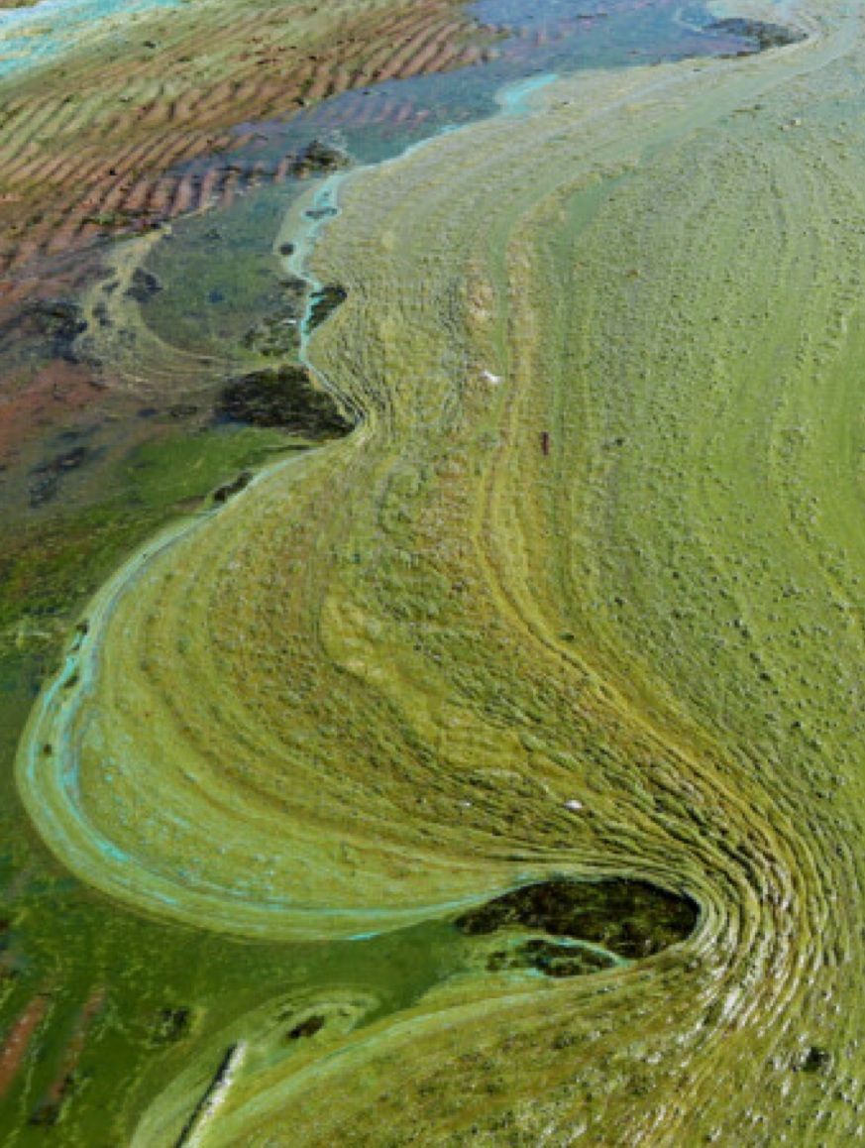
Scope of WG is being changed to reflect advances in past actions and work done by Natalie Lerma (Knauss Fellow 2024)
This WG is in the process of updating Terms of Reference, Action Plan and Members list.
Piloted by US Office, in collaboration with GEO Aquawatch
ESRI is autonomous in providing the SDG 14.1.1a to UNEP. Methodology is in the process of being written up for publication (Emily is still involved in that)
Current co-chairs are wishing to step down (Merrie Beth (NOAA) and Keith (ESRI))
New activities with the UNEP Global Partnership on Nutrient Management (GPNM) are being explored to convene the GEO Work Programme to provide a coordinated answer to their needs along the entire nutrient lifecycle.
A workshop with UNEP and some representatives of the Work Programme was held in Paris in Jan 2025 to explore some possible first steps for collaboration
A community event was proposed at the GEO Global Forum
Eutrophication Working Group

Slide 16
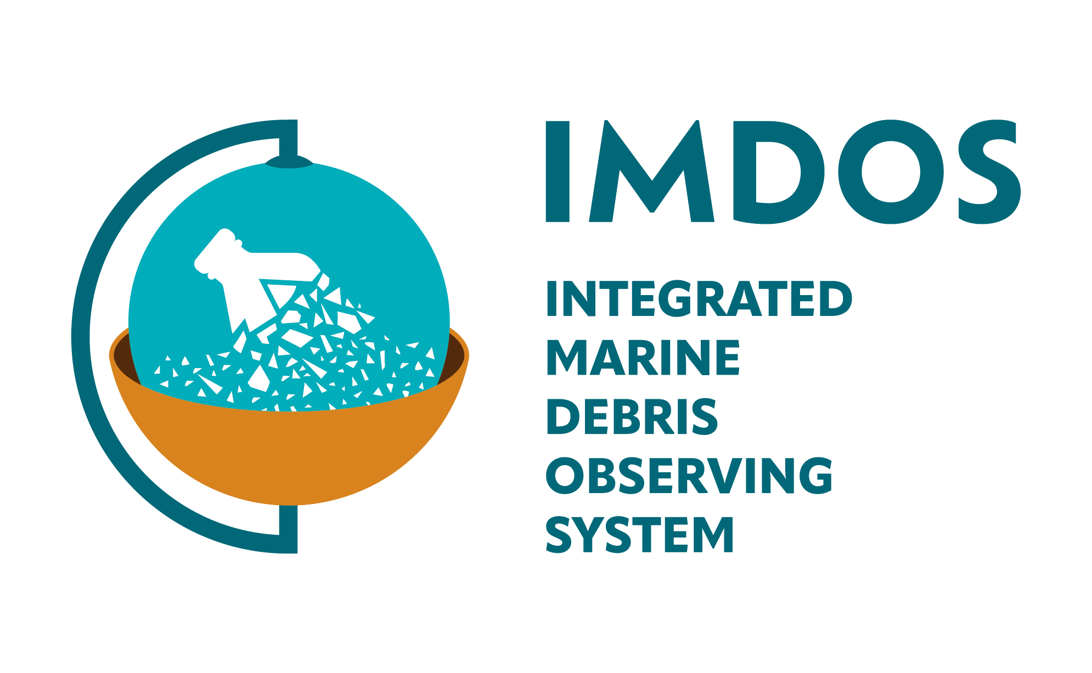
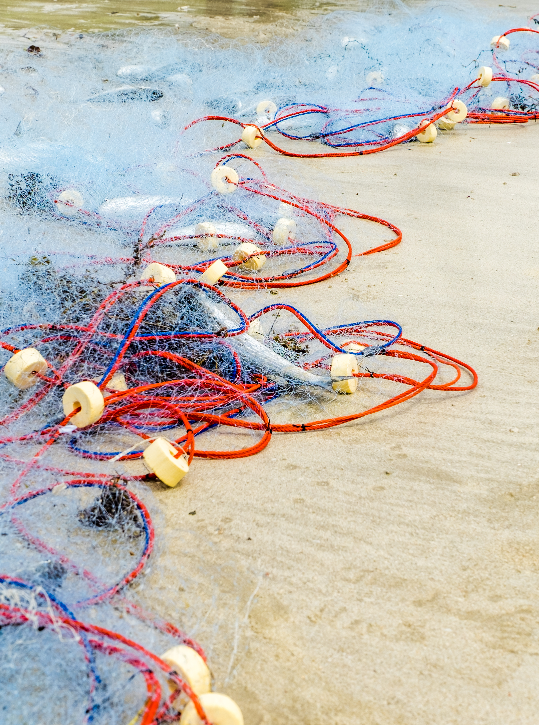
IMDOS is being set in motion and the WG will resume
Very successful call launched in July for interest to be on SC and in TT
Sec duties transferred to Daphne Lecellier (EU Office)
IMDOS Steering Committee has been launched in Jan 2025 with about 35 members
11 task teams with 2 co-chairs have been identified. Adding members now
GEO Blue Planet to (only) support the 3 “stakeholder engagement” Task Teams
Data to Policy
Link with the treaty
Coordination of Regional actions
GOOS as endorsed IMDOS as a project and will be providing support (subcontract)
Next steps include
Setting up the WG (composed of the 3 TT)
Update Terms of Reference
Support IMDOS comms + search of funding
Marine Litter Working Group

Slide 17
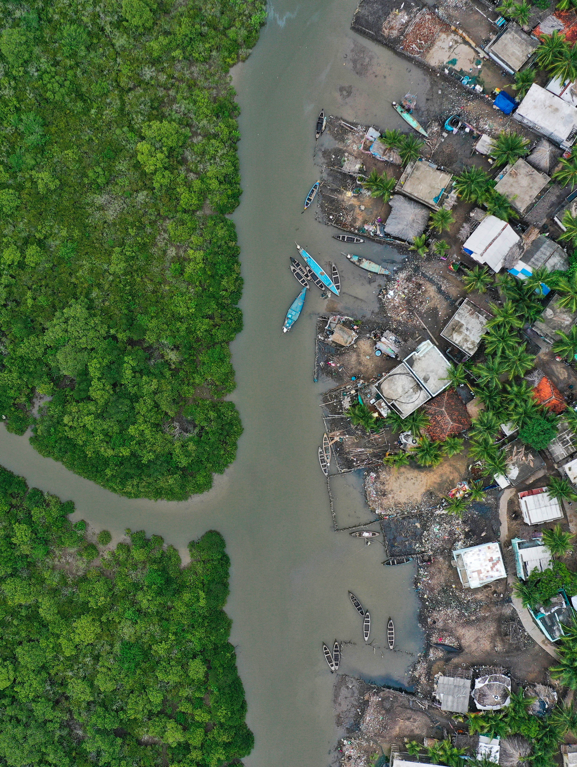
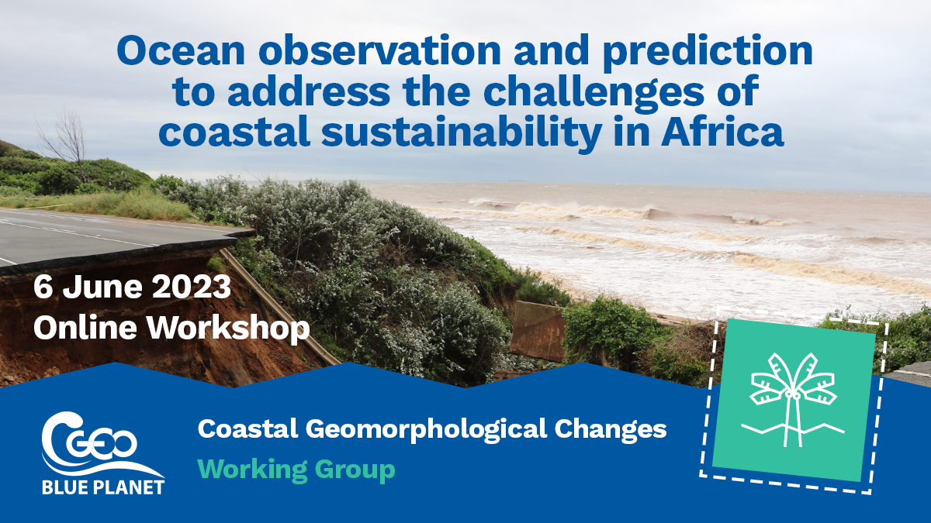
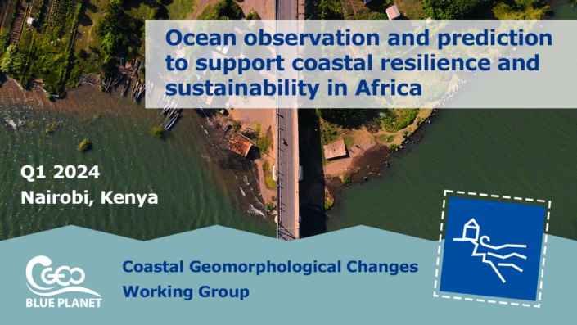
WG unactive since creation. Should benefit from the March 2024 Workshop at UNEP HQ
Created in 2022, but no Action Plan and thus unactive. No Monthly meeting.
Outcomes from the workshop entitled “Ocean Observation and Prediction for Coastal Sustainability in Africa” held in Nairobi in March 2024 should feed this WG, although focused on the African continent.
This group could be re-installed in 2025 if stakeholder needs + active members are identified
OPERA (EC DG INTPA) project (2025-2027) included some outcomes of workshop, and this group could work with them with a wider scope (INTPA is focused on Africa solely)
Any comment on scope from the ExComm ?
Coastal Resilience Working Group

Slide 18
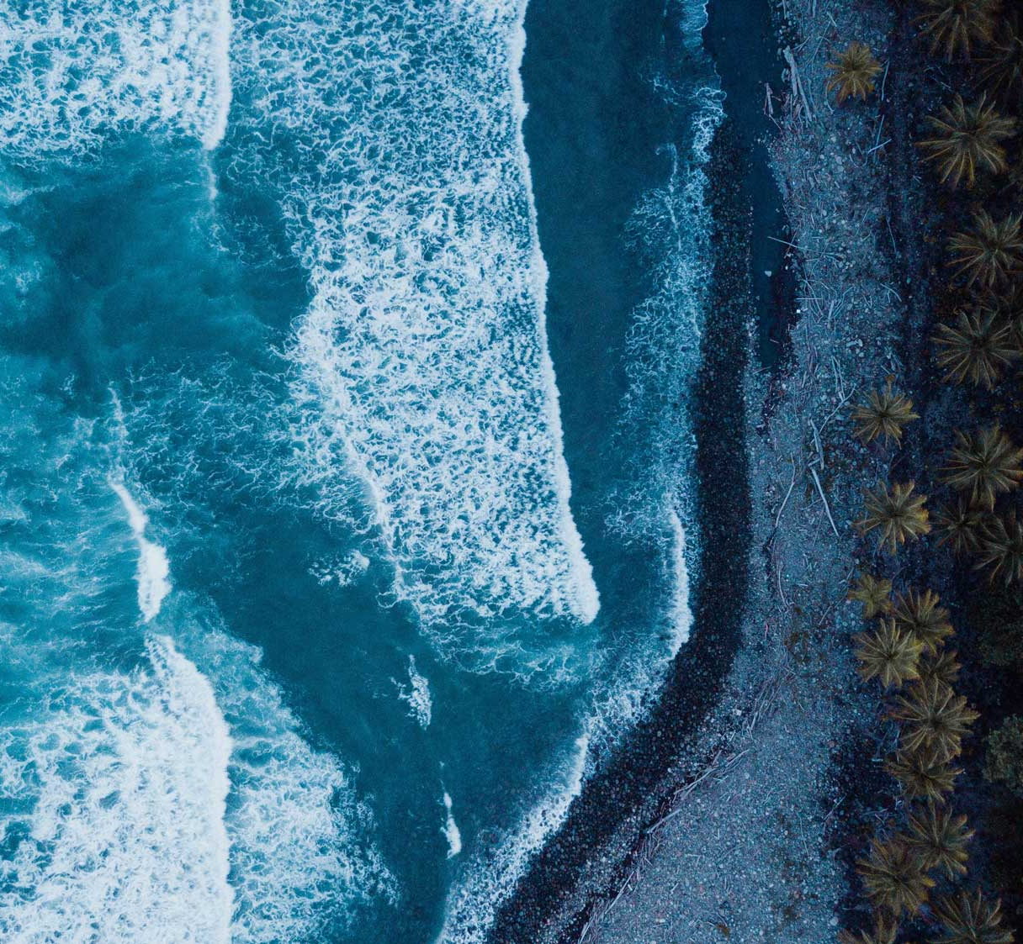
Other Activities

Slide 19
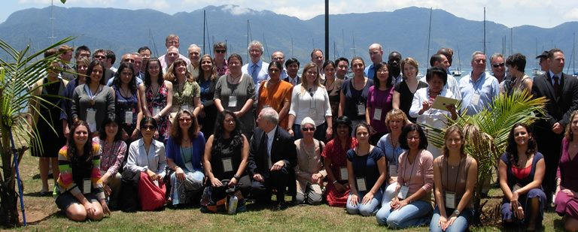



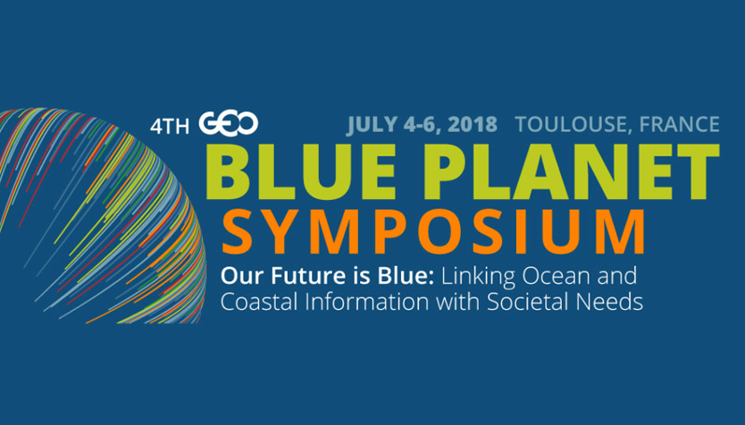
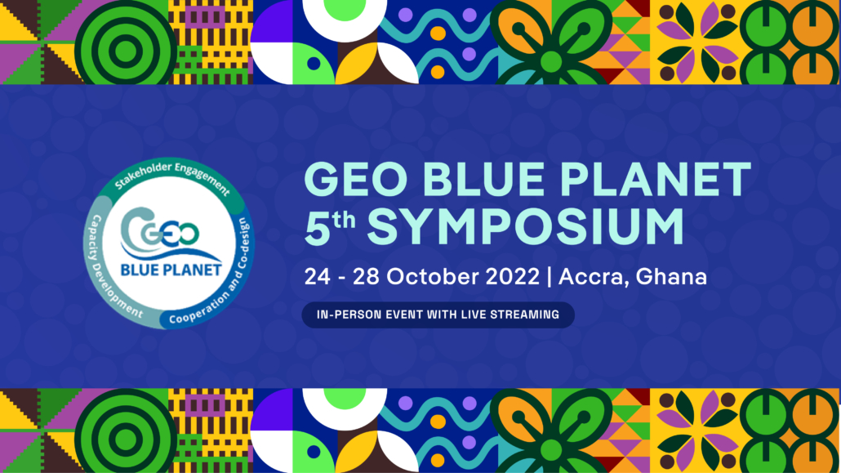
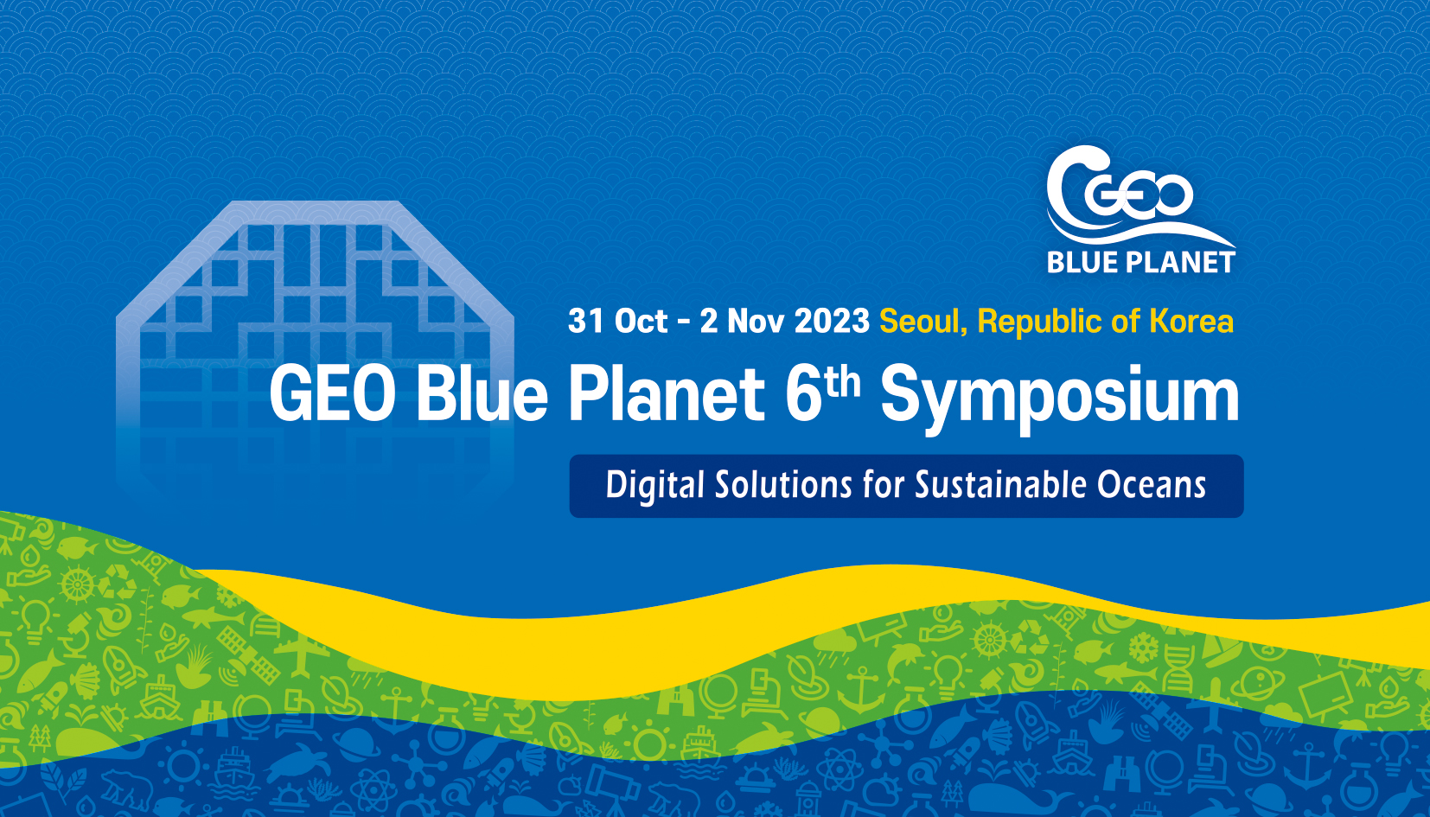

GEO Blue Planet Symposia
The Kick-off symposium was co-sponsored by the Canadian Space Agency (CSA), GEO, INPE and POGO in Brazil, 2012
2026

Slide 20
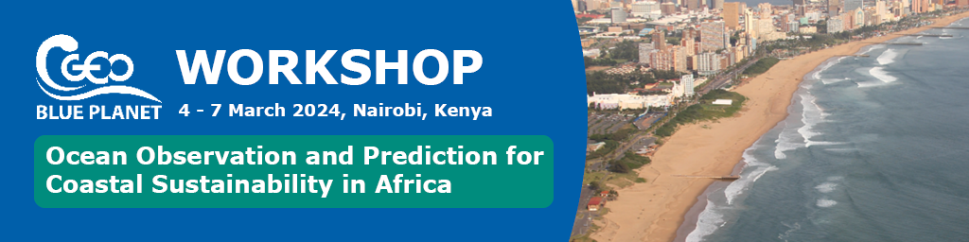
Shoreline and seabed mapping
Coastal flooding and inundation
Coastal ecosystem mapping
Coastal waters quality
Main Objective: Understand stakeholders needs aligned with the AU blue strategy, the UN Ocean Decade roadmap for Africa and UNEP regional conventions strategies.
Two days of plenary sessions, with presentations on
policy, blue economy and decision making and their needs for Ocean observation and prediction.
ocean, coastal hazards, blue carbon and observation and predictions capabilities in Africa.
Earth-observation based products and services for Africa.
Two days of break out workshops on four Thematic Areas where participants were guided to:
map actors
discuss value chain versus decision making chain
co-create a concept for an EO-based service/tool

Slide 21
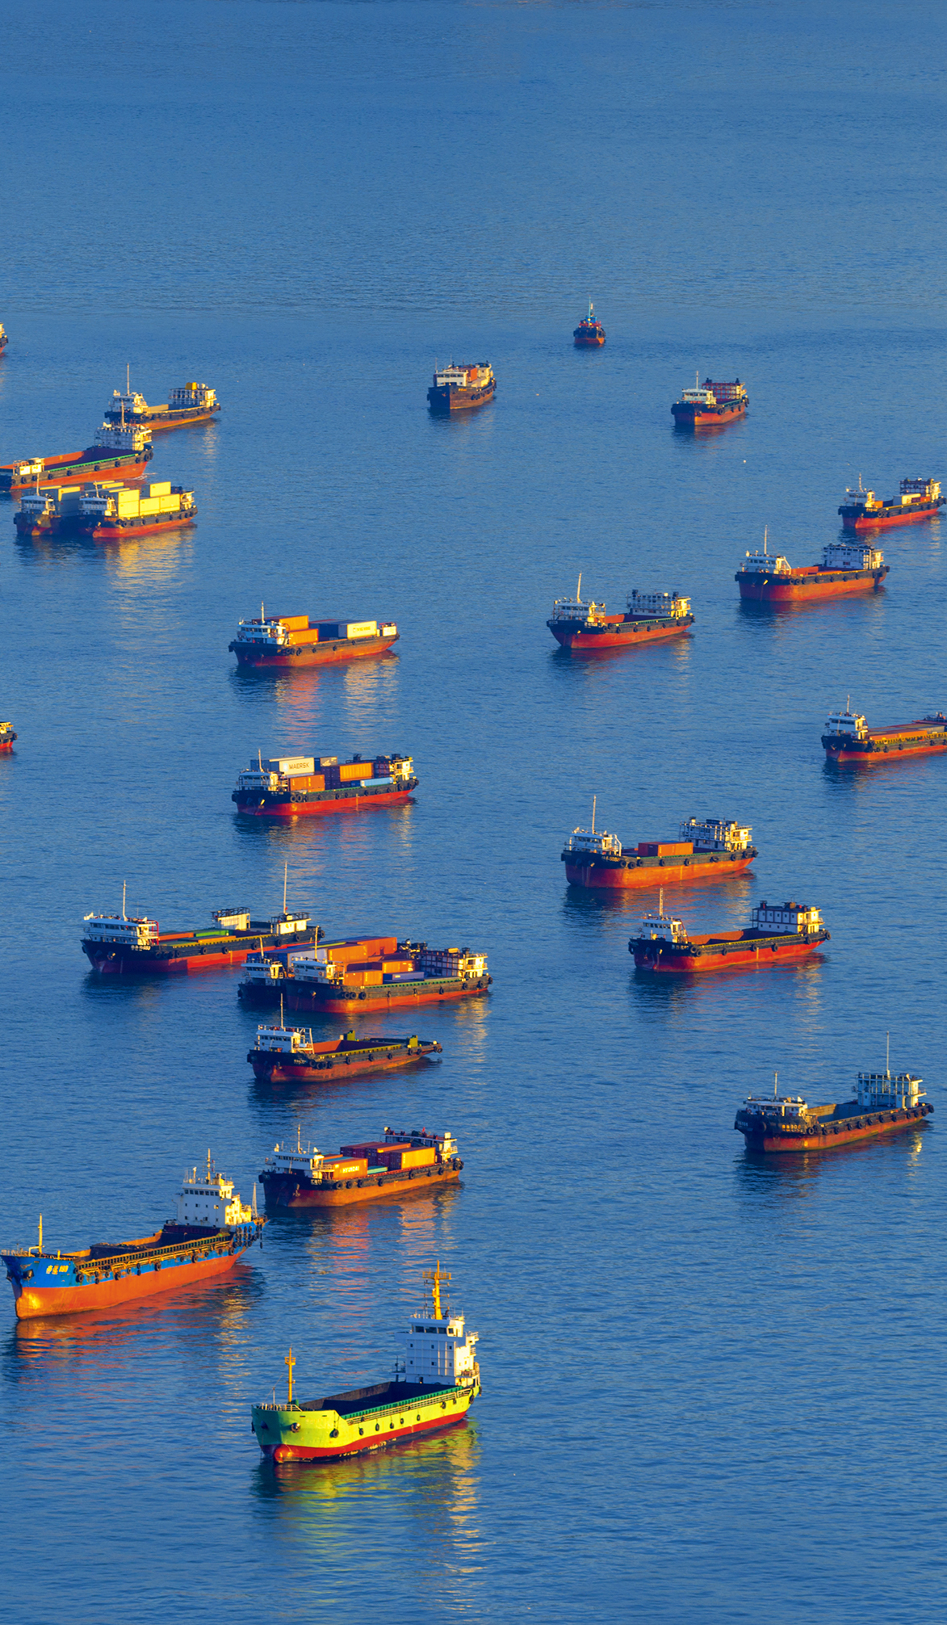
THANK YOU
https://geoblueplanet.org/
https://sargassumhub.org/
https://imdos.org/
info@geoblueplanet.org
https://www.linkedin.com/company/geo-blue-planet

